Slide 1
Macroeconomic modelling of climate change: current situation and challenges
Prof. Dr. Luljeta Minxhozi
First Vice-Governor
Bank of Albania
1 October 2020
www.bankofalbania.org

Slide 2
Introduction
Living in unprecedented times: transformative and deep-rooted changes
COVID-19 pandemic
Widening inequalities
Environmental and climate changes
→ Testing our core values of solidarity, openness, and even democracy
The negative effects on public health, economic prospects, and even political stability (Rüttinger, et al. 2015, COACCH 2018) will be amplified…
… with vulnerable populations that will see more volatile and extreme weather conditions (esp. Southern and Eastern Europe, such as Albania)
Therefore, we can no longer afford to ignore these challenges: We all have a role to play in helping addressing these challenges
Notes:
We are living in unprecedented times. Times of transformative and deep-rooted changes that people are living in: Widening inequalities on the one hand, environmental and climate changes, on the other, are both testing core values such as solidarity, openness, and even democracy. COVID-19 crisis was also a wake-up call, a rare window of opportunity to shift toward a more resilient and better world for everyone.

Slide 3
Climate Change and Central Banks
Climate risks are unusual:
Broad-based effects (affecting all types of economic actors, sectors of the economy and regions)
Uncertainty of the horizon, nature and scale of these risks
Longer planning cycle to manage climate-related risks
Climate related risks affect everyone – governments, companies and households, across countries and continents → Far-reaching effects
Mitigating these risks requires sustained, concerted, and effective co-ordination between everyone over many years to come
Climate change has already become part of central banks agenda, given their objective of price and financial stability

Slide 4
BoA’s contribution to Climate Action
BoA stepping up its efforts in modeling and mitigating climate changes:
Conducting analysis and/or research on climate related risks
Aiming to integrate climate factors into Monetary policy, Financial Stability Monitoring and Supervision
Considering best practices for incorporating and promoting more effective disclosures on climate-related risks
Stepping up cooperation on climate change and resilience
Collaborating with State Secretariat for Economic Affairs (SECO), to incorporate in macroeconomic models and forecasting tools the relevant climate-related risks (stress-tests, climate-based scenarios)
Since 2017, part of the “Resolution on Global Sustainable Development”
Financing and investing in the implementation of the Paris Agreement (COP21) on climate change
(Albania signed Paris agreement on 22 April 2016 in New York)
BoA intends to join other central banks efforts, such as the Central Banks and Supervisors Network for Greening System (NGFS)
Promoting a green, inclusive, sustainable and resilient economy – in resonance with the UN’s 2030 Agenda for SDGs
Notes:
These lasts years BoA has demonstrated a willingness to contribute to the production of analysis and/or research on climate related risks issues, performing a stocktaking exercise of existing practices and regulations complemented by a comprehensive analysis.
At the same time, the Bank is aiming to integrate climate factors into Financial Stability Monitoring and Supervision, and start considering best practices for incorporating and promoting more effective disclosures on climate-related risks.
Most importantly, in collaboration with State Secretariat for Economic Affairs (SECO), BoA is aiming to incorporate in macroeconomic models and forecasting tools the relevant climate-related risks (stress-tests, climate-based scenarios).
On 13-14 July 2017, the Bank of Albania participated in the Seventh Global Sustainable Finance Conference in Karlsruhe, Germany, supporting the UN resolutions on 'Sustainable Development Goals' and the Paris Climate Agreement.
At the BoA, to overcome some of these challenges, we believe that we should open up to broader research issues by becoming active in some supervisory fora that are considering the impact of climate change on different parts of the financial sector (banks, investment funds, insurance companies, etc.) and/or becoming part of international networks, such as the Central Banks and Supervisors Network for Greening System (NGFS), that we are waiting at any moment now, to be part of.

Slide 5
Why climate change is an important issue in Albania?
The average temperature is going to increase by 1.5° during the next 40 years which is much more the temperature increase verified during the last 50 year (0.5°) World Bank 2013.
The precipitation are expected to decrease from 30 to 90 mm/year.
These changes are going to have an important impact on two key sectors of Albanian Economy
Agriculture and
Energy
Other side effects as flooding which are going to be more recurrent, have to be taken into account too.

Slide 6
Share of Agriculture and Energy in Production
Notes:
Agriculture plays an important role in the Albanian economy as it remains one of the largest sectors:
Total land area of 28,750 square kilometers, of which 24% of soil (or nearly 700 000 ha) is used for agriculture purposes
The sector generates around a fifth of the national output
It employs nearly half of the country´s workforce as it is the main source of (self) employment in the rural areas
From 1997 to 2015, agricultural production has grown at a decent rate, averaging annually at 3.8 percent.
The energy sector with around 2% of the GDP…
… is almost entirely dependent on hydropower for its electricity supply
With an advantage in decarbonizing its electricity sector…
…but highly vulnerable to the changing climate, meaning that it has to import electricity most of the years
Renewable energy in Albania counts for 34.5% of total energy used in the country
(https://bankwatch.org/beyond-coal/energy-sector-in-albania)

Slide 7
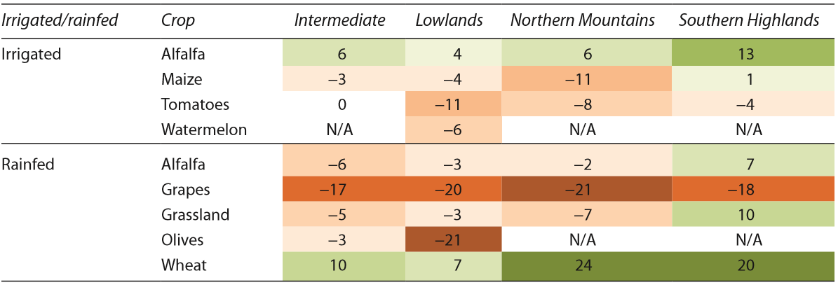
Effects of climate change on Agriculture production
An analysis is made on the effects the climate change on arable cultures and some vegetables on the annual yields.
Table 1. Effect of Climate Change on Crop Yield 2040–50 Relative to Current Yields under Medium-Impact Scenario, No Irrigation Water Constraints and without New Adaptation Measures (% change)
Sources: World Bank, 2013
Note: Results are average changes in crop yield, assuming no effect of carbon dioxide fertilization, under medium-impact scenario (no adaptation and no irrigation water constraints). Declines in yield are shown in shades of orange, with darkest representing biggest declines; increases are shaded green, with darkest representing the biggest increases. N/A = crop is not grown in that AEZ, according to local stakeholders.

Slide 8
Potential economic impact of agriculture and electricity power shocks due to climate changes
The medium-impact scenario suggests that:
Climate change impact could result in 6-13% of yield reduction → reflected on a 2-4 % of agriculture production reduction;
Annual rainfall reduction is estimated to cause a contraction of electrical power production by one-tenth.
The economic impact is evaluated by using MEAM – a macro econometric model at the Bank – although not really suitable for sectorial analysis, still useful
A fall in agriculture and electric power production, using MEAM, could lead to a:
Deterioration in external trade balance (assuming perfect substitution of goods);
Decline of Albanian gross domestic production between 0.6 and 1.0% (two-thirds of it stemming from agriculture).
These developments could exert pressure on:
Weakening the exchange rate;
Rising consumer prices,
Migration of workers from agriculture sector to other more productive economic sectors

Slide 9
Conclusions: The BoA operates sustainably
Albania is one of the most vulnerable countries in the Western Balkan Region to the changes of climate trends
Two sectors that are the most impacted by these shifts in climate are agriculture and energy.
Bank of Albania takes these climate risks seriously and tries to model their impact on Albanian economy
Climate risks and impacted variables...:
Beyond lost of the GDP and
Volatility of commodities prices, …
… Hence, Bank of Albania is making efforts to step up its understanding, discussion and implementation of these risks in its policies across board.
One thing is clear:
The costs of inaction will be much greater than the cost of action!
Notes:
To conclude, we can safely say that: The costs of inaction will be much greater than the cost of action, and the Bank’s mission, namely safeguarding financial stability, fully resonates with the UN’s 2030 Agenda for SDGs. Hence, in order to ensure a resilient financial system that operates in the best interests of consumers and the wider economy, BoA is placing emphasis on “green” content.
We are starting by creating an environment where financial risks related to climate change can be assessed and considered more efficiently, therefore channelling the savings into the needed investment, facilitating sustainable finance growth and supporting a sustainable economy.

Slide 10
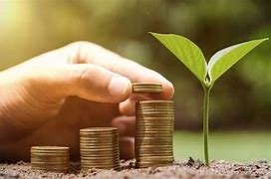
THANK YOU
FOR YOUR ATTENTION

