Slide 1
* CBDC *
Selected Topics
Tommaso Mancini-Griffoli
Monetary and Capital Markets Department, IMF
BCC 9th Annual Conference, September 23, 2021

Slide 2
What?
1

Slide 3
History moves in uneven steps
Telegraph
Telephone
Radio
TV
Cell & internet
1830
1880
1900
1930
1990
“Things take longer to happen than you think they will, and then they happen faster than you thought they could.”
-- R. Dornbusch
Is “digital money” of equivalent caliber?

Slide 4
Size and growth warrant attention
Cryptoassets
CBDC
70 % IMF membership
20 requests for TA in 6 months
2.5 trillion
10% of NY stock exchange
10x growth since 2018 FSB

Slide 5
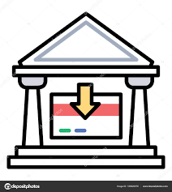
Bank Deposits vs. Digital Money and Cryptoassets
Private money
Public money
Not money
E-money
Stablecoins
CBDC
Cryptoassets
Denomination
National currency
Same as banks
Same as banks
Same as banks
Own
Redemption pledge
Fixed @ face value
Fixed
None
None
Flexible
Backstop
Government
Private
Private
None
None
Backing asset
Mixed
Safe & liquid
Safe
None
None
Varied

Slide 6
Why?
1

Slide 7
CBDC comes with potential benefits…
Safety, resilience, market discipline
Financial inclusion
Efficiency of public policy
Catalyst for innovation & growth
Rights of citizens
Cross border payments
Not the only solution

Slide 8
… as well as risks…
Banking sector disintermediation
Reputation (resilience, integrity…)
Resilience
Financial integrity
Consumer protection
Can be managed

Slide 9
… and wider policy challenges and opportunities
Privacy & data
Fiscal policy efficiency
Legal frameworks & treatment
Currency substitution
Monetary policy independence, Control of financial conditions, FX regime
Public – private partnerships
Capital flow management & effects
Banking and credit provision
Payment fragmentation/ integration
Competition
Digital divide
Climate
Backstops and reserve currencies

Slide 10
CBDC exploration is advancing and widespread
Action
Questions
IMF collaboration
Bahamas
China
Eastern Caribbean
Nigeria
What is CBDC?
Implications?
Design options?
Should we?
Bilateral CD
Peer learning
Joint analytical work
Japan
Korea
Sweden
Ukraine
Objectives
Capacity assessment
Payment strategy
Design
Piloting and analysis
Euro area
Mauritius
Russia

Slide 11
Financial Inclusion
1

Slide 12
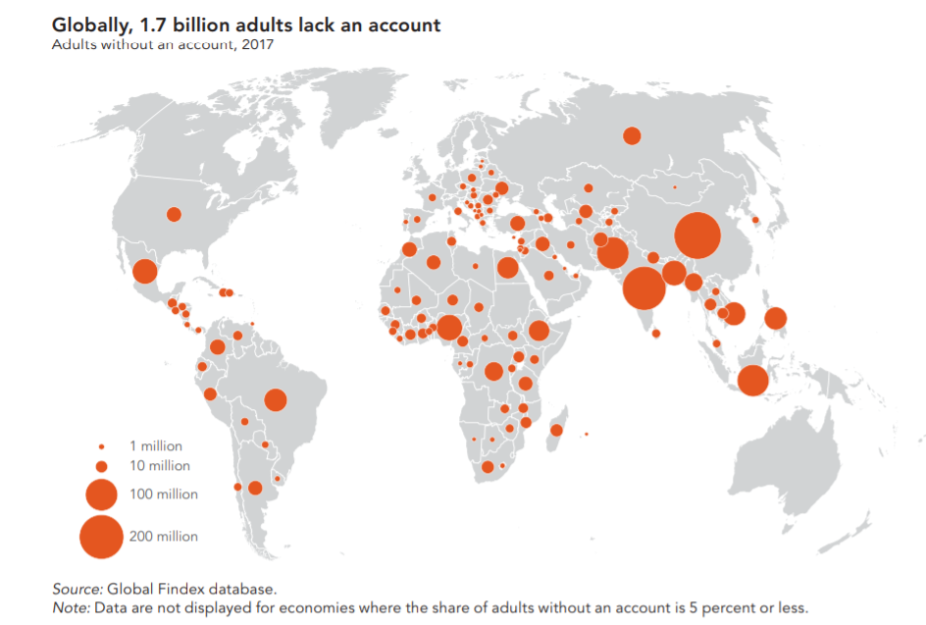
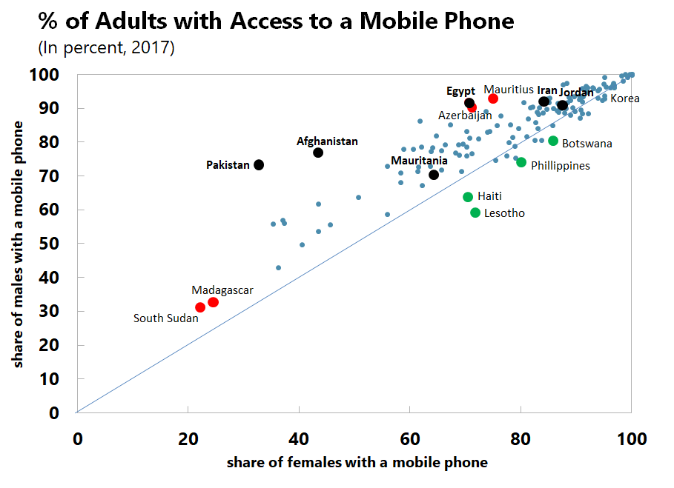
A global challenge
Globally, 1.7 bn people lacked an account… nearly half live in 7 countries
…but mobile phone ownership is widespread amongst men & women
Source: World Bank, G20 Financial Inclusion Indicators. Note: Green (purple) indicate examples of countries with higher female (male) ownership of mobile phones than male (female).

Slide 13
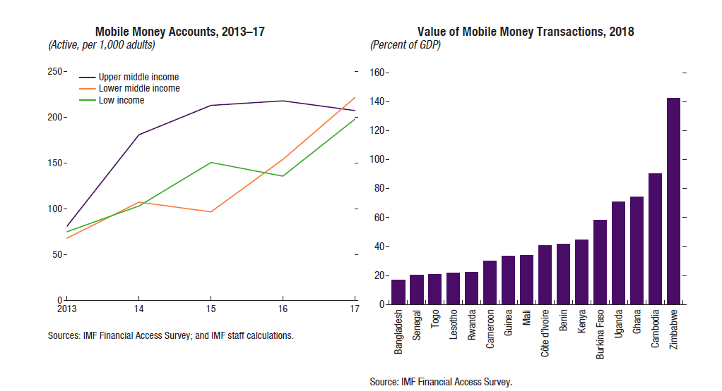
Digitalization can be a game changer (1/2)
(i) mobile devices, (ii) communication technology (such as Wi-Fi & GPS), (iii) big data, (iii) processing power, (iv) cloud computing and (v) advanced analytics

Slide 14
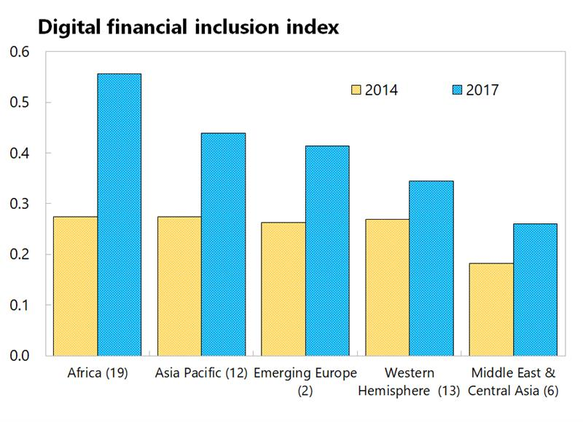
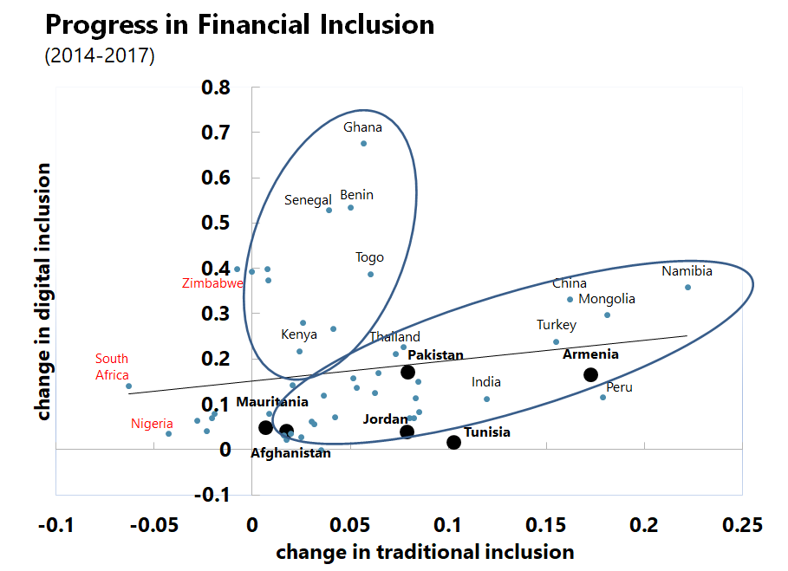
Digitalization can be a game changer (2/2)
Africa and Asia-Pacific leading in adoption of digital payments…
…but it is growing everywhere, even when traditional is not
Source: Global Findex, FAS, GSMA, ITU, IMF Staff Calculations. Indices ranges from 0 to 1 where 1 indicates higher financial inclusion. Traditional and digital financial inclusion indices are not directly comparable. Based on a sample of 52 emerging and developing countries for which data is available. The numbers in parenthesis in the LHS chart shows the number of countries included in each region.

Slide 15
Some barriers to micro & small enterprises
Today
Tomorrow
Low deposits/ loans
Traditional servicing costs > gains
Incomplete financial data
Little collateral
Better access / digital IDs
Low service costs, automated decisions
Real-time data gathering
Data as collateral
Complementary services

Slide 16
Privacy
1

Slide 17
CBDC could help privacy vs integrity tradeoff
Privacy
Financial integrity
Cash
Bank deposits
CBDC with “traceable anonymity”
14
Notes:
In designing money, national authorities face a tradeoff between satisfying legitimate user preferences for privacy (something that can be very important in many societies) and at the same time mitigating risks to financial integrity.
Cash protects privacy because it is anonymous as it can be used for transactions with no account and no record needed.
However, cash (especially large denomination bills) also facilitates criminal financial transactions (such as money laundering, financing of terrorism, corruption, and tax evasion.)
CBDC can protect privacy without undermining integrity if it is designed with
(1) limits on the size of anonymous transactions.
(2) appropriate customer due diligence (CDD) procedures, and transactions recorded.
(3) identity of parties is revealed only if illicit activity is suspected
While promising on paper, an important question is whether users would trust the safeguards established to protect their privacy (ie, the governments’ promises that it would not seek to identify transactions unless there are serious and credible concerns about their nature).

Slide 18
Banking Disintermediation
1

Slide 19
Will the two sides of banks’ balance sheets split?
What are welfare consequences?
Banks
Welfare implications?
Credit services
Liquidity services
Moral hazard of fractional banking
Summers (1975); Pennacchi (2012); Cochrane (2014)
Disciplining effect of demandable deposits
Calomiris & Kahn (1991)
Liquidity creation and lending complementarities
Diamond & Rajan (2001); Kashyap, Rajan & Stein (2002)
Uninformed investors prefer opacity
Gorton & Pennacchi (1990); Dang, Gorton, Holmstrom & Ordonez (2017)
Social value of liquidity transformation?
Illiquid, long-term
Essential for growth
Within and cross-network settlement
Stable, low-cost funding
Monopoly power (1)
Government backing (2)
Investment funds
Stablecoins
CBDC
(other digital money)
Drechsler, Savov, and Schnabl (2018) E.g. deposit insurance, LOLR, ELA, supervision

Slide 20
CBDC could disintermediate the banks
Banks
Central Bank
CB reserves
Customer deposits
Bonds
CB reserves
CBDC
But how much should we expect?
What can we do about it?

Slide 21
In simple static model, disintermediation can be large
CBDC introduction: Leftward shift in supply
Interest on deposits
Baseline simulations*
Supply of deposit funding
Effects larger if CBDC offers interest
And if demand is flatter
 | U.K.* | Portugal*
Change in deposit quantities | - 10% | - 0.1%
Change in deposit rates | + 17 bps | + 25 bps
Demand for deposit funding
Deposit disintermediation
Quantity
(*) Simulations assume a liquidity value of (s)CBDC of 50 bps (possible lower bound to negative rates before deposits move to cash) and elasticity of deposit demand and supply to interest rate movements based on Chiu and Hill (2018) for the U.K., and Canhoto (2004) for Portugal. Elasticities may vary depending on the level of interest rates.

Slide 22
But in dynamic model, harder to get disintermediation
Interest on deposits
Supply shifts back in, as banks improve payment services
Demand shifts up as banks accept lower margins
Disintermediation is less; could even reverse
Quantity

Slide 23
Results change widely with household assumptions
Liquid assets
Illiquid assets
A
Baseline
Deposits
Cash
Bonds
B
Introduction CBDC
Deposits
CBDC
Cash
Bonds
C
Intensive margin
Deposits
CBDC
Cash
Bonds
D
Deposits
CBDC
Bonds
Fixed costs
E
Asymmetric costs
Deposits
CBDC
Bonds

Slide 24
Effects through banks must also be investigated
Mechanical
Amplification through regulatory constraints
Deposits
Lending market
Can monetary policy offset higher lending rates?
Margins & loan rates
Profits
Amplification through capital ratios?
Access to data?
Ability to compete on non-pecuniary dimensions?
Production function

Slide 25
“Current wisdom” still generally holds
 | Disintermediation may not be large (at least in short-medium run) Banks can fight back: better services, higher deposit rates, partnerships
 | Central bank can recycle funding to banks But politically sensitive (viable during crisis, not extensively in normal times?)
 | Price limits: CBDC bears (increasing) penalty rate beyond certain wallet size See Bindseil (2020)
 | Quantity limits: wallets capped, and surplus is swept into bank accounts See Bahamas Sand Dollar Project
1
2
3
4
Urgent need for general equilibrium models

Slide 26
Cross border use
1

Slide 27
Potential advantages
Fewer intermediaries
Greater competition
Greater transparency
Common standards ; clean slate
Safety and integrity
24 x 7 hours
Cheaper, faster, more transparent & accessible ?

Slide 28
Cross-border CBDC raise design & technical challenges
 | Direct ownership | Intermediation
Retail | AML / CFT Standards | Market design
Wholesale | Market liquidity Info sharing | Role of central banks
Tech standards
AML / CFT
Market design
Liquidity
Data & information sharing
Role of central banks
…

Slide 29

Inthanon-LionRock
CB
CB
W
R
W
R
1
W
4
2
W
A
B
W
3
https://www.bot.or.th/English/AboutBOT/Activities/Pages/Inthanon_LionRock.aspx
https://www.hkma.gov.hk/eng/news-and-media/press-releases/2020/01/20200122-4/

Slide 30
Macrofinancial challenges must also be addressed
Larger gross flows more leverage & greater valuation changes
Circumvention of capital flow management measures
More widespread currency substitution
    Monetary policy and foreign exchange intervention effectiveness
    Lender of last resort
    Faster transmission of global financial conditions
    Loss of information / tax revenue
Configuration of reserve currencies (slow? regional?) and backstops
Payment system fragmentation
Digital divide

Slide 31

Need for global cooperation
September 27 Banca d’Italia / G20 Conference:
Enhancing Digital and Global Infrastructures in Cross-border Payments - Day 2 - YouTube
1

Slide 32
* CBDC *
Selected Topics
Tommaso Mancini-Griffoli
Monetary and Capital Markets Department, IMF
BCC 9th Annual Conference, September 23, 2021

