Slide 1





Digital currencies impact on domestic and international
payments
Central Bank of
the Republic of Azerbaijan

Slide 2
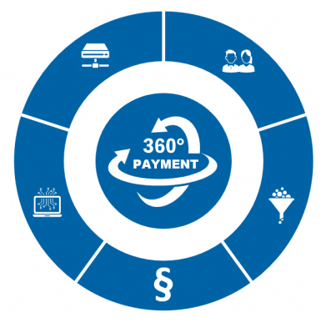
Key Drivers of Payment Industry Development
Changed Market Infrastructure
Changed Customer Behavior
New Technologies
Changed Competitive Environment
New Regulatory Initiatives

Slide 3


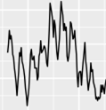
Payment systems and services are changing
Increasing competition
between payment systems​
New systems and
their impact on users
International trends and decline
in the use of ATM network
Changing role of
the interbank systems

Slide 4
Digital Payments Strategy of
the Central Bank of Azerbaijan for 2021-2023
Improving the legislation on digital payments and providing innovative solutions
1
Increasing financial literacy, encouraging businesses and the public to actively use digital payment services
Expansion of the coverage area of digital and standardized payment infrastructure
5
2
Digital Payments
Strategy
Enhancing the inclusion on digital payments and providing universal access to remote banking services
4
3
Development of a risk-based regulatory
and supervisory framework for
the payment ecosystem
Action 4.3. Conceptual approach to the digital manat
Source: https://uploads.cbar.az/assets/Digital_Payment_Strategy_public_final_08.06_v02_ENG_final.pdf
4

Slide 5
Considerations in CBDC design
Smart
contracts
Interest
Offline technology
Legal topics/ license
Privacy
Testing Environment
Private
Public
DLT
Access
Settlement
finality
Distribution
channels
Irrevocability
Technology choices
Operational choices
Risk management

Slide 6
Thank you !
Ms. Khayala Mammadova
Senior Specialist
National payment system development and oversight division
Payment systems & settlements department
The Central Bank of the Republic of Azerbaijan
E-mail: Khayala_Mammadova@cbar.az

