Slide 1
Card acceptance by small merchants: An application of the Tourist Test to Peru
José Aurazo
BCRP, TSE
Milton Vega
BCRP
BCC 9th Annual Conference 2021
The views expressed by the authors should not be interpreted as those of the Central Reserve Bank of Peru.

Slide 2

Outline
01
Motivation
02
Tourist test
03
Data and estimation approaches
04
Calculations of the tourist test threshold
05
Conclusions

Slide 3
Motivation
1

Slide 4

Motivation
Competition
Weak competition
High merchant discount rates (MDR) and interchange fees
Issues
2018
Low level of financial inclusion
Large informal economy
Low access and usage of digital payments
Peru’s Competition Authority launched a Market Study to assess competition conditions in the market for payment cards.
Peru
2020
The two main acquirers became multi-brand and the card networks (e.g., VISA, Mastercard) started to set the interchange fees (before it was set by the 80/20 rule of the MDR).
28%
of adults in Peru have a debit card
12%
of adults in Peru have a credit card
Source: Global Findex (2017)

Slide 5
Tourist Test
2

Slide 6

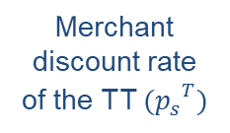

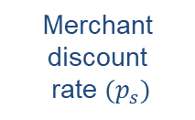


The Tourist Test
Merchants will accept debit card payments if they are as costly as cash. The level of interchange fee that meets that criteria is called by Rochet and Tirole (RT 2011) as the “tourist test threshold”. According to Fung et al. (2018):
Interchange fee $(a)$
Excess
Operating costs
Merchant discount
rate ${(p}_{s})$
Interchange fee of the TT $(a^{T})$
Merchant discount rate
of the TT ${{(p}_{s}}^{T})$
Acquirer cost ${(c}_{s})$
Acquirer cost ${(c}_{s})$
Fraud and other costs
Operating and other costs
Operating and other costs
Marginal cost
of cash
Marginal cost
of cards
Tourist test (TT)

Slide 7
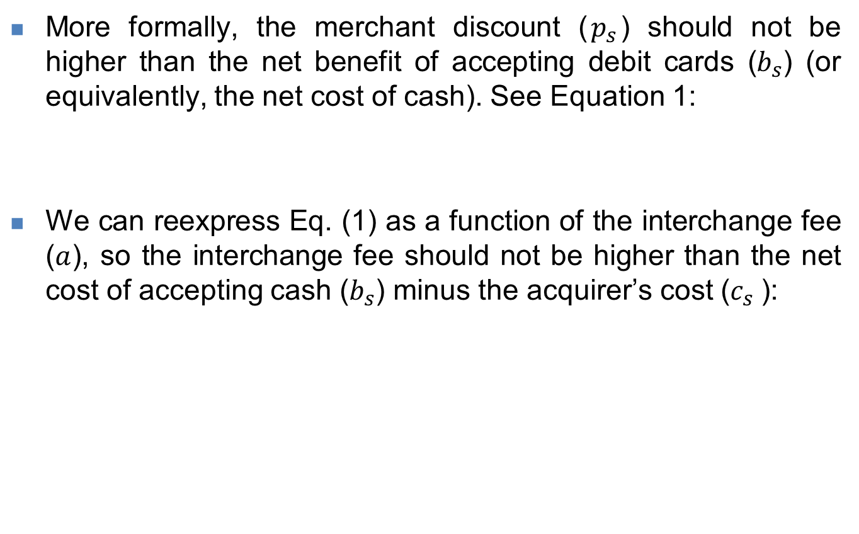

The Tourist Test
More formally, the merchant discount ($p_{s}$) should not be higher than the net benefit of accepting debit cards ($b_{s}$) (or equivalently, the net cost of cash). See Equation 1:
We can reexpress Eq. (1) as a function of the interchange fee ($a$), so the interchange fee should not be higher than the net cost of accepting cash ($b_{s}$) minus the acquirer’s cost ($c_{s}$):
$$p_{s}≤b_{s}$$
(1)
$a≤b_{s}−c_{s}$
where:
$a:$is the interchange fee paid by acquirers to card issuers,
$b_{s}$: is the net benefit of accepting cards or the net cost of cash, and
$c_{s}$: is the acquirer’s cost.
(2)

Slide 8
Tourist Test with tax evasión (I)
In RT 2011, the operating costs are the main factors involved in accepting debit card payments. However, for developing countries like Peru, there is another factor to consider in the merchant’s decision: tax evasion (associated with cash payments).
This concept was developed by Aurazo and Vasquez (2020) who included evasion of the VAT in cash payments in the tourist test model.
The idea is that a share of cash payments are not reported to the Tax Authority, so merchants receive an extra benefit derived from evading VAT when accepting cash payments.

Slide 9

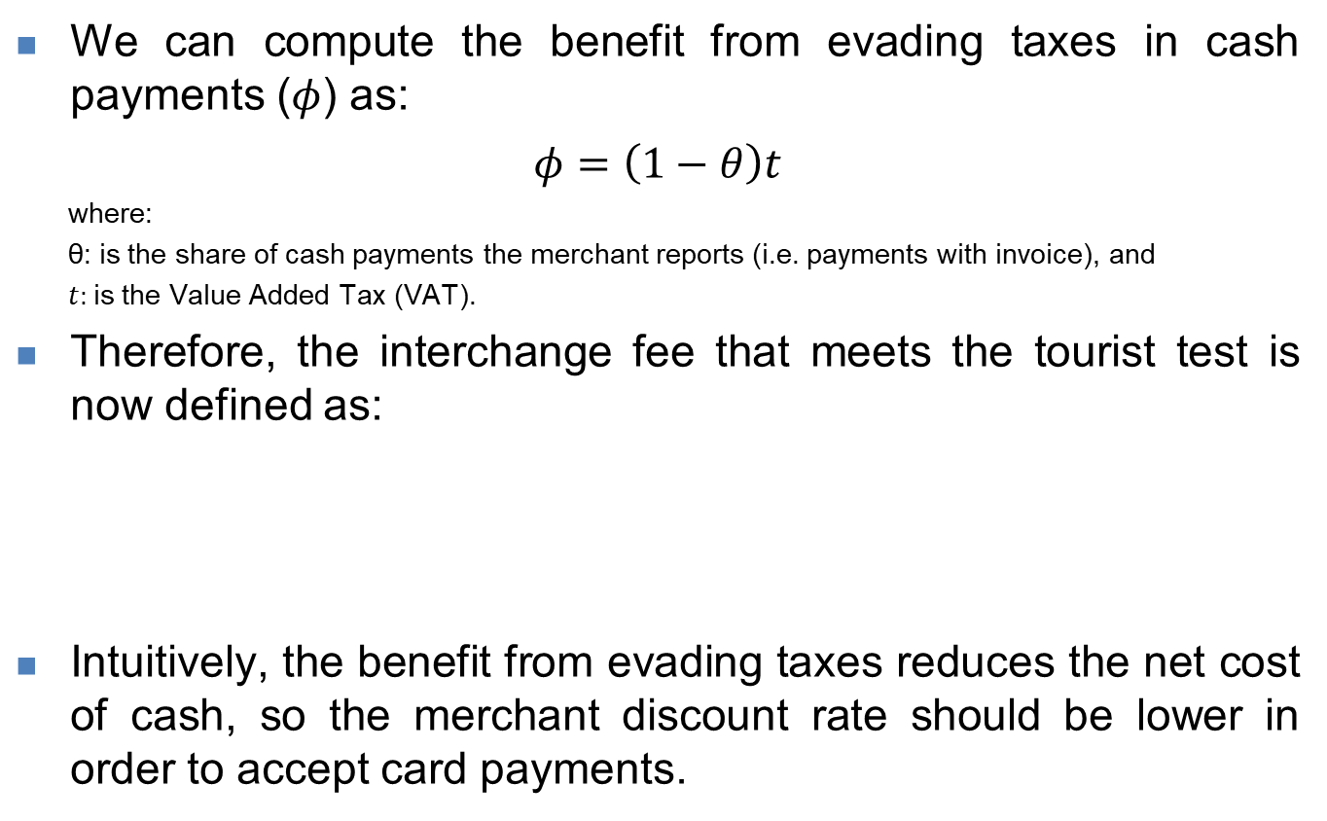
Tourist test with tax evasión (II)
We can compute the benefit from evading taxes in cash payments ($φ$) as:
$φ=\left(1−θ\right)t$
  where:
  θ: is the share of cash payments the merchant reports (i.e. payments with invoice), and
  $t:$is the Value Added Tax (VAT).
Therefore, the interchange fee that meets the tourist test is now defined as:
Intuitively, the benefit from evading taxes reduces the net cost of cash, so the merchant discount rate should be lower in order to accept card payments.
$a≤b_{s}−c_{s}−φ$
Or equivalently:
    $p_{s}≤b_{s}−φ$
(3)
(4)

Slide 10
Data and estimation approaches
3

Slide 11





The Small Merchants Survey
Some results:
Value of sales by payment instrument, %
Objective population
Debit cards
Small merchants with a POS
Credit cards
1 063
Cash
Small merchants
PEN 39
average ticket per
cash payment
71.8%
frequency of providing receipts
+47%
PEN 58
average ticket per
card payment
87.4%
frequency of providing receipts
Between April-July 2019
+15.6%
7
main cities in Peru
The Survey collected four types of costs: customer service (front-office), operational management (back-office), taxes, and others.
Main reasons for accepting card payments:
attraction of new consumers (87%)
greater security offered by accepting card payments (86%)

Slide 12
Estimation of the tourist test threshold
Two approaches:
Standard: We have to make some assumptions about the distribution of costs between value-related and volume-related. The interchange fee is also a function of the transaction value.
Cash-Flow: Small merchants live day-to-day and recalculating costs in each transaction can be costly for them. They estimate their costs in terms of the average ticket of each payment instrument as a proxy of the expected ticket.

Slide 13
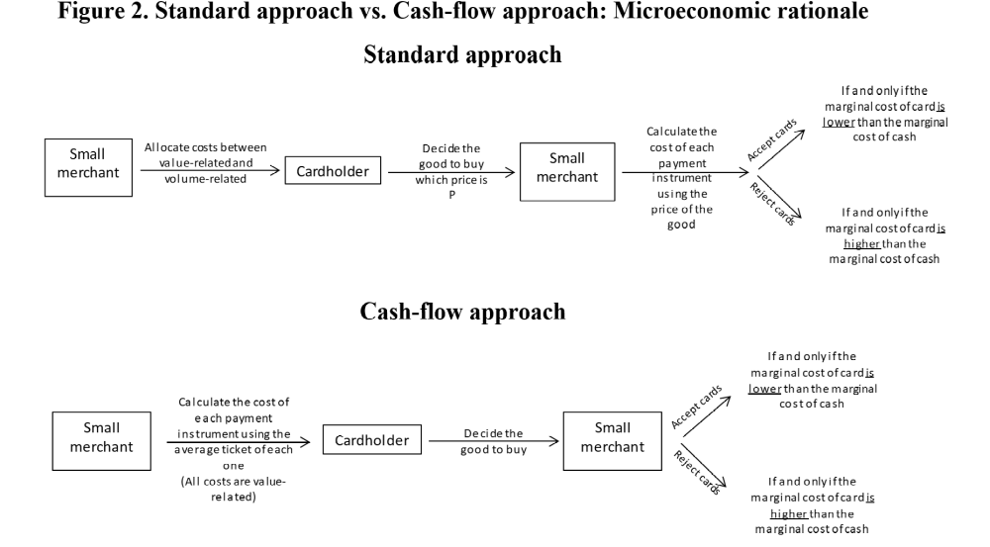
Standard vs. Cash-flow approach

Slide 14
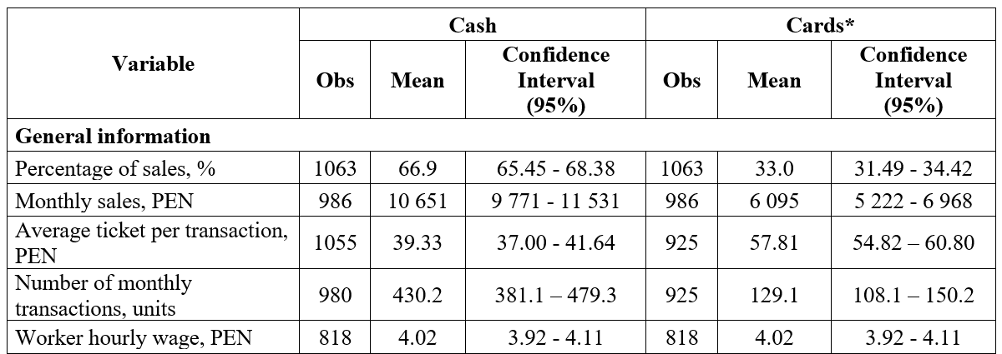
Data on sales and costs (I)

Slide 15
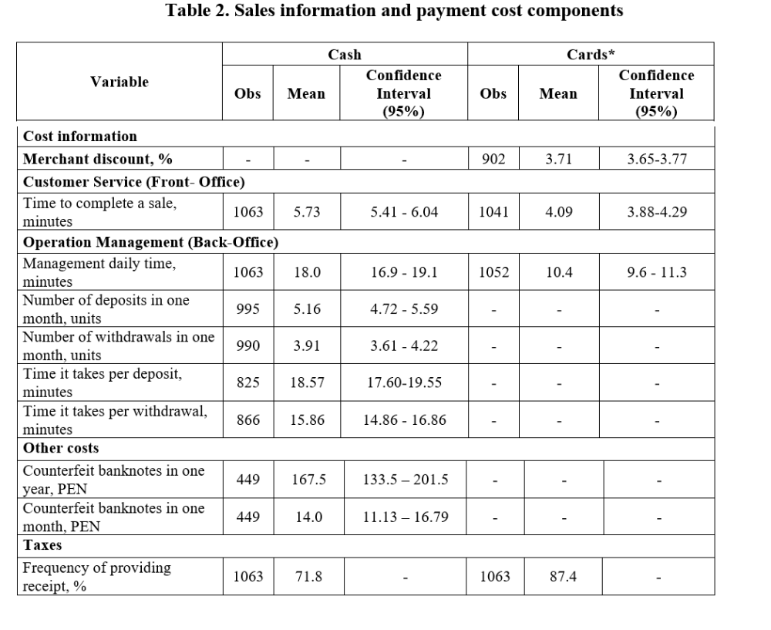
Data on sales and costs (II)

Slide 16
Estimates
of the tourist test threshold
4

Slide 17
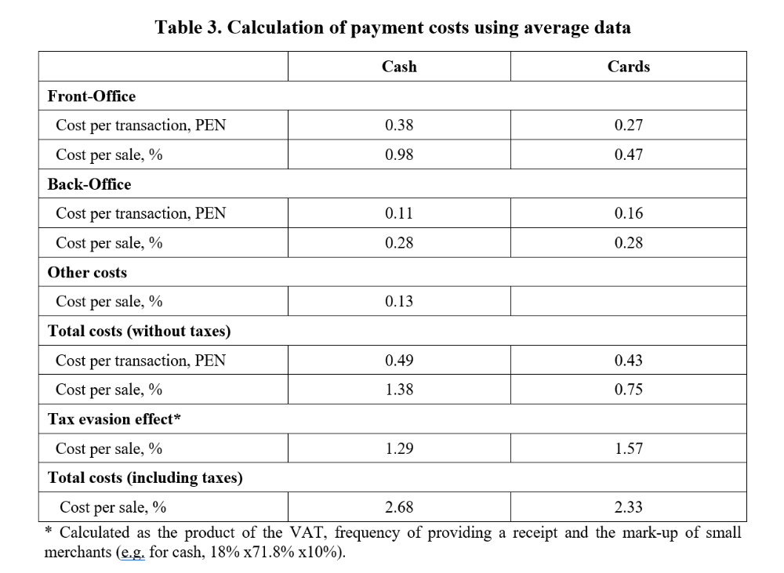
Estimates of cost of accepting cash and card payments

Slide 18
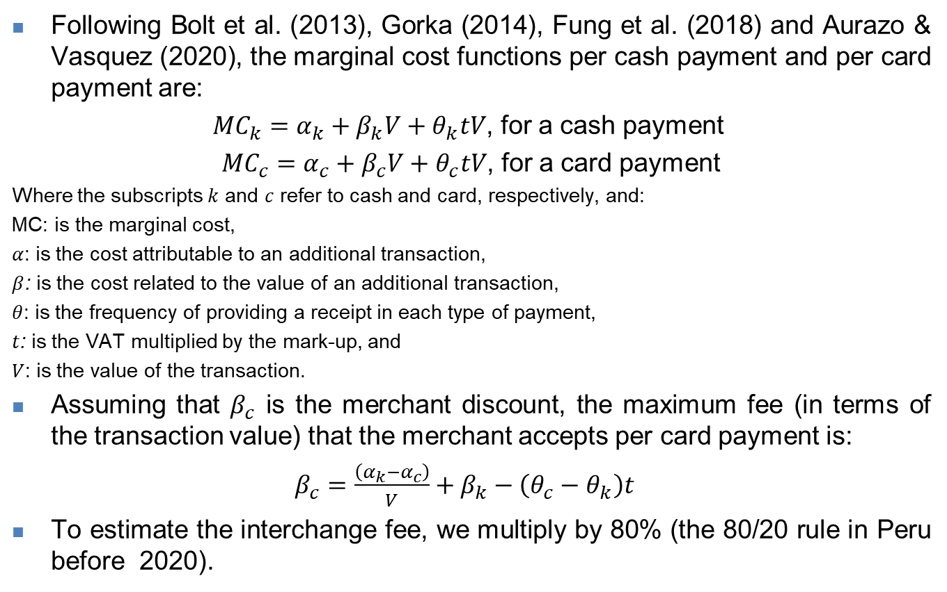
Estimates using the standard approach (I)
Following Bolt et al. (2013), Gorka (2014), Fung et al. (2018) and Aurazo & Vasquez (2020), the marginal cost functions per cash payment and per card payment are:
${MC}_{k}=α_{k}+β_{k}V+θ_{k}tV$, for a cash payment
${MC}_{c}=α_{c}+β_{c}V+θ_{c}tV$, for a card payment
Where the subscripts $k$ and $c$ refer to cash and card, respectively, and:
MC: is the marginal cost,
$α$: is the cost attributable to an additional transaction,
$β$: is the cost related to the value of an additional transaction,
$θ$: is the frequency of providing a receipt in each type of payment,
$t$: is the VAT multiplied by the mark-up, and
$V$: is the value of the transaction.
Assuming that $β_{c}$ is the merchant discount, the maximum fee (in terms of the transaction value) that the merchant accepts per card payment is:
$β_{c}=\frac{\left(α_{k}−α_{c}\right)}{V}+β_{k}−\left(θ_{c}−θ_{k}\right)t$
To estimate the interchange fee, we multiply by 80% (the 80/20 rule in Peru before 2020).
(5)

Slide 19
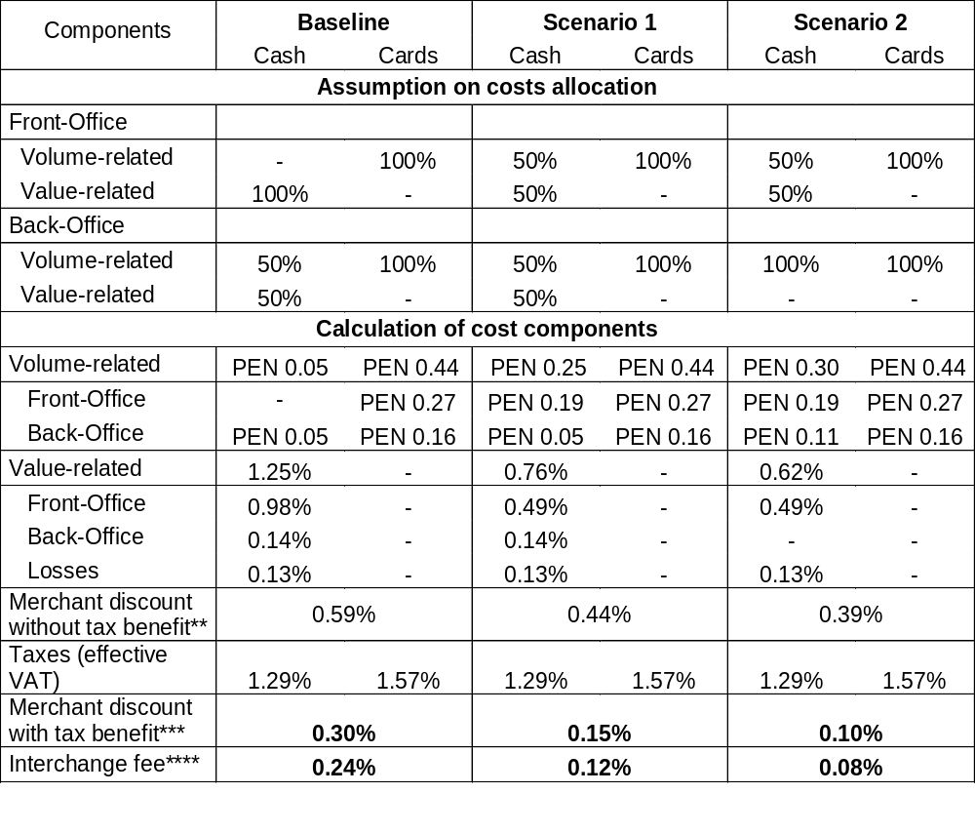
Estimates using the standard approach (II)

Slide 20
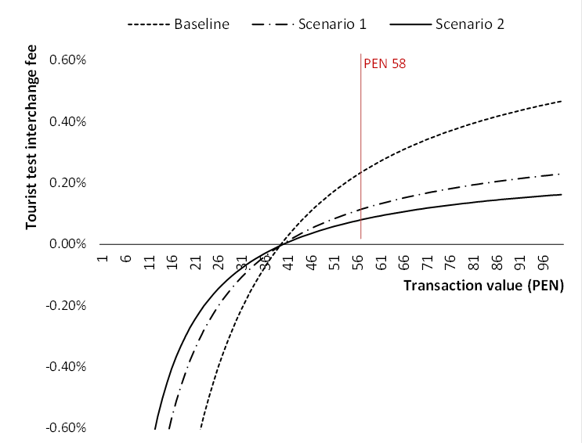
Estimates using the standard approach (III)

Slide 21
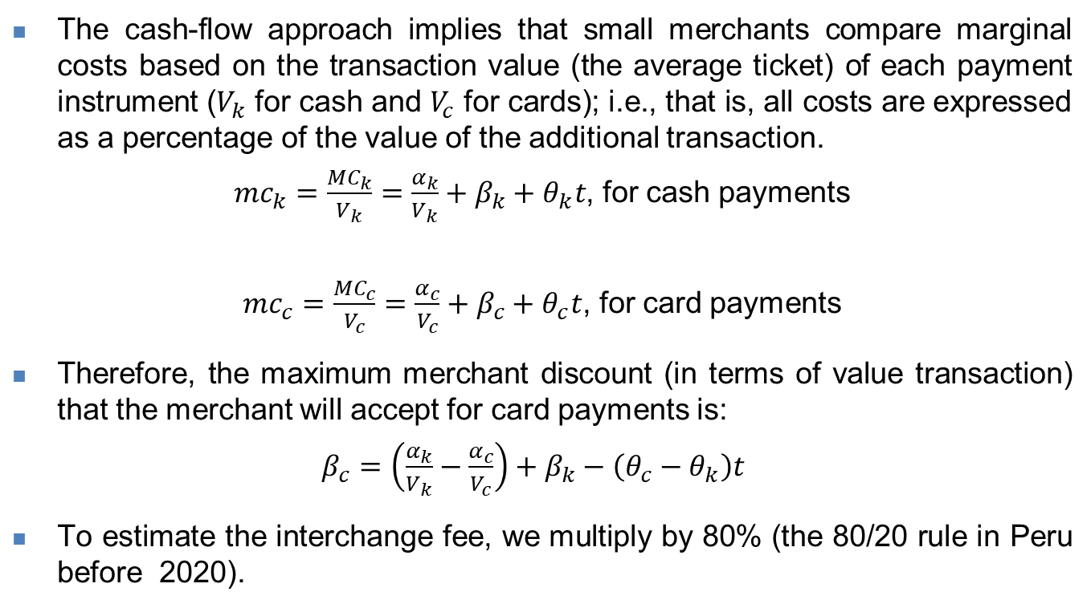
Cash-Flow approach (I)
The cash-flow approach implies that small merchants compare marginal costs based on the transaction value (the average ticket) of each payment instrument ($V_{k}$ for cash and $V_{c}$ for cards); i.e., that is, all costs are expressed as a percentage of the value of the additional transaction.
${mc}_{k}=\frac{{MC}_{k}}{V_{k}}=\frac{α_{k}}{V_{k}}+β_{k}+θ_{k}t$, for cash payments
${mc}_{c}=\frac{{MC}_{c}}{V_{c}}=\frac{α_{c}}{V_{c}}+β_{c}+θ_{c}t$, for card payments
Therefore, the maximum merchant discount (in terms of value transaction) that the merchant will accept for card payments is:
$β_{c}=\left(\frac{α_{k}}{V_{k}}−\frac{α_{c}}{V_{c}}\right)+β_{k}−\left(θ_{c}−θ_{k}\right)t$
To estimate the interchange fee, we multiply by 80% (the 80/20 rule in Peru before 2020).
(6)

Slide 22
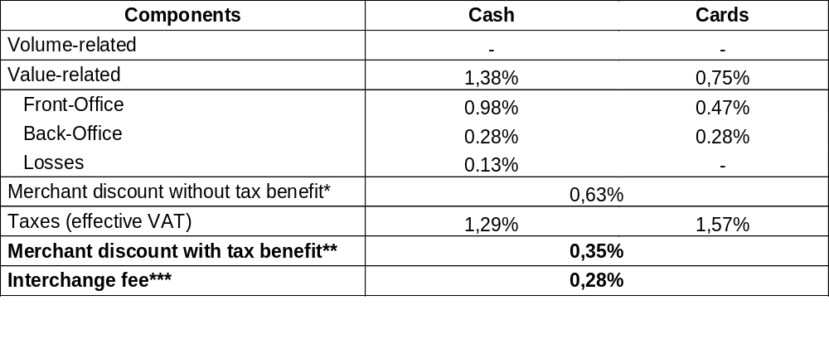
Cash-Flow approach (II)
Using average data, we have:
(*) Considers the standard components of the operating costs for cash and cards.
(**) Considers the standard components of the operating costs for cash and cards net of the benefit from evading taxes.
(***) Calculated as the 80% of the merchant discount with the benefit from tax evasion.

Slide 23
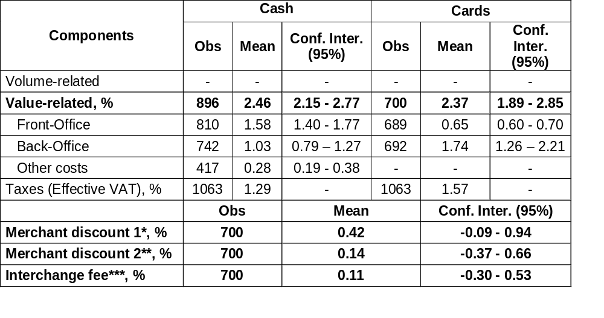
Cash-Flow approach (III)
Alternatively, the tourist test threshold can be estimated for each merchant who answered the survey and calculate an average for the group:
Note: Means and confidence intervals are calculated using the expansion factor of the population size. Effective VAT calculated with a mark-up of 10%.
(*) Considers the standard components of the operating costs for cash and cards.
(**) Considers the standard components of the operating costs for cash and cards and the benefit from evading taxes.
(***) Calculated as the 80% of the MDR with the benefit from tax evasion.

Slide 24
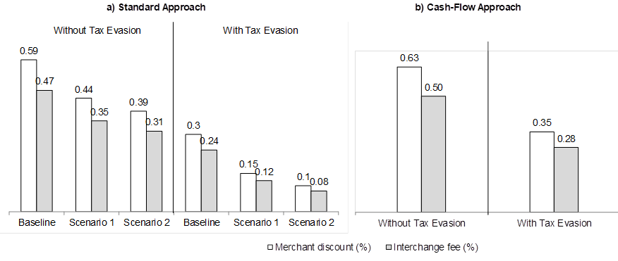
Comparing results
The benefit of evading taxes reduces both the merchant discount rate and interchange fee that make small merchant indifferent between cash and card payments, since they tend to evade taxes more often in cash payment than in (debit) card payments.
The interchange fee for debit cards resulting from the cash-flow approach is slightly higher than the interchange fee based on the standard approach.

Slide 25
Conclusions
5

Slide 26
Final Comments
We use the Tourist Test as a benchmark to estimate the level of the interchange fee using information about merchant’s operating costs with cash and cards payments.
We introduce a new empirical methodology coined as the cash-flow approach, where the merchant calculates costs relative to the value of a transaction with cash and card, This approach allows to have a result not linked to assumptions about the distribution of costs or level of transaction.
Also, we use an extended version of the Tourist Test that includes tax evasion linked to cash payments that helps to explain why merchants may not be indifferent between cash and card payments, even when the merchant discount rate level reflects the Tourist Test calculation.

Slide 27
Card acceptance by small merchants: An application of the Tourist Test to Peru
José Aurazo
BCRP, TSE
Milton Vega
BCRP
BCC 9th Annual Conference 2021

