Slide 1

How should the interaction between Ministry of Finance and Central Bank be structured?
7th Annual Conference of the Bilateral Assistance
and Capacity Building for Central Banks (BCC) programme
Juan Ospina
Deputy Governor for Monetary Policy and Economic Information
September 27, 2019

Slide 2

Coordination between Ministry of Finance and Central Bank
Answer
  How should the interaction between Ministry of Finance and Central Bank be structured?
Given the institutional framework :
Law
Central Bank’s governance structure
Central Bank’s mandate
Interaction between finance ministries and central Banks
September 27, 2019

Slide 3
Coordination between Ministry of Finance and Central Bank
Answer
  How should the interaction between Ministry of Finance and Central Bank be structured?
Given the institutional framework :
Law
Central Bank’s governance structure
Central Bank’s mandate
My answer – from the Central Bank’s perspective:
It should be structured at ALL LEVELS of both, Ministry of Finance and Central Bank, in a way that guarantees and promotes the implementation of an effective monetary policy framework
Interaction between finance ministries and central Banks
September 27, 2019

Slide 4
Coordination between Ministry of Finance and Central Bank
Why?
  What is an effective monetary policy framework?
An effective regime will have beneficial first-order effects on welfare by reducing uncertainty, anchoring inflation expectations and reducing the incidence and severity
of boom-bust cycles.
(Freedman and Laxton 2009)
Blanchard, O. (2004). Fiscal dominance and inflation targeting: lessons from Brazil (No. w10389). National Bureau of Economic Research
Interaction between finance ministries and central Banks
September 27, 2019

Slide 5

Coordination between Ministry of Finance and Central Bank
Why?
  Fiscal dominance: an example of failure, and a call for coordination between monetary and fiscal authorities
Under normal conditions:
$$π↑ →r↑→π↓$$
But what if public debt is high enough, such that:
$$π↑ →r↑→p\left(default\right)↑ →ε↑→π↑$$
Blanchard, O. (2004). Fiscal dominance and inflation targeting: lessons from Brazil (No. w10389). National Bureau of Economic Research
Interaction between finance ministries and central Banks
September 27, 2019

Slide 6
Coordination between Ministry of Finance and Central Bank
Some evidence of coordination
  Any signs of coordination in Latin America?
Interaction between finance ministries and Central Banks
 | Colombia | Chile | Mexico
Board of Directors | 6 members + minister | 5 members | 5 members
Autonomy | ✓ ✓ ✓
Coordination | Market of public debt
 | Foreign debt operations
 | Technical assistance |  | x
 | Deposit accounts | Deposit accounts | Deposit accounts
 | Minister of finance presides the board, and has voice and vote. | Minister of finance assists to the board meetings, has voice but does not vote
Interaction between finance ministries and central Banks
September 27, 2019

Slide 7
Coordination between Ministry of Finance and Central Bank
Colombia
  Case of Colombia: Constitutional mandate
Art. 371: The following shall be the basic functions of the Central Bank:
Regulate the money supply, international exchanges, and credit
Issue legal tender
Manage international reserves
Be lender of last resort and banker of the credit institutions
Serve as government’s fiscal agent
All these functions shall be exercised in coordination with the general economic policy
Interaction between finance ministries and central Banks
September 27, 2019

Slide 8
Coordination between Ministry of Finance and Central Bank
Colombia
  Elements of an effective monetary policy framework in Colombia
Nominal anchor as target in medium to long-term
  Inflation
  Decision making process to achieve the inflation target
Transparent mandate in terms of their targets and their operative independence to achieve them.
  Political constitution and laws (Art. 371, 373 and judgement 481/99)
  Decisions taken by the board
Price stability should be the policy target over the medium term
  Political constitution (Article 373)
  Policy decision making process
To determine the magnitude and the required pace of adjustment to achieve the long term monetary target, the CB has to know the implication of their decisions over macroeconomic activity and financial stability.
  Laws (Article 371 of political constitution and C-judgement 481/99)
  Decision making process worried about the economic activity and the coordination with other macroeconomic actors
Interaction between finance ministries and central Banks
September 27, 2019

Slide 9
Coordination between Ministry of Finance and Central Bank
Colombia
  Elements of an effective monetary policy framework in Colombia
Publicly known scheme: establish explicit quantitative nominal target for inflation for a specific number of periods ahead.
  Inflation target: 3% (+/- 1%)
  Commitment to have an inflation report with forecast to 2 – 3 years
  Policy horizon: 2 years
An instrument and operative framework that align the markets with the policy position
  Policy interest rate that align interbank market rates
  Auction quotas expansion and contraction
  SGII, DTIE, financial sector y public sector
Transparent and forward-looking monetary policy strategy
  Monetary policy decision making process that leads to future analysis and carries to …
  Inflation report
  Use short and medium term forecast models. Macroeconomic consistency.
Central Bank transparency and accountability
  Report to the Congress of Republic (Laws), Minutes.
  Markets and general public: Inflation report based on the same information that the board receives, which is an outcome of the same technical analysis.
Interaction between finance ministries and central Banks
September 27, 2019

Slide 10
Coordination between Ministry of Finance and Central Bank
Colombia
  Examples of Different Levels of Interaction to Guarantee Effectiveness
Operational level: Treasury Committee and Monetary and Foreign Exchange Intervention Committee
  Since CB is the government’s bank, cash in the bank is cash out of the economy
  Fiscal Analysis Unit projects government’s cash holdings at the CB
  Finance Ministry’s Treasurer shares forecasts and special future operations that will affect cash holdings
  Financial Sector Unit estimates money demand
  Deputy Governor for Monetary and International Investments defines a money supply strategy
  Recent Example:
  Treasury is holding more cash
  Strategy: hold back on payments to guarantee meeting target of fiscal rule
  In the future: hold more cash as all government units may be require to take cash to treasury’s accounts
Interaction between finance ministries and central Banks
September 27, 2019

Slide 11
Coordination between Ministry of Finance and Central Bank
Coordination in practice
  However, there is always room for improvement
Treasury deposits at the end of the month (line) vs Central Bank’s forecasts
Interaction between finance ministries and central Banks
September 27, 2019

Slide 12
Coordination between Ministry of Finance and Central Bank
Colombia
  Element # 6. An instrument and operative framework that align the markets with the policy position
Interaction between finance ministries and central Banks
September 27, 2019

Slide 13
Coordination between Ministry of Finance and Central Bank
Colombia
  Examples of Different Levels of Interaction to Guarantee Effectiveness
Monetary Strategy and Forecasting Process Level:
  Once a quarter the Ministry’s Macroeconomic Policy Team and the Inflation Report team meat
  Discuss information for nowcast
  Share information on forecast of GDP components
  Fiscal analysis unit gets information from Treasury Committee and government’s cash flow forecasts to produce a forecast for G and T in GDP measures
Interaction between finance ministries and central Banks
September 27, 2019

Slide 14
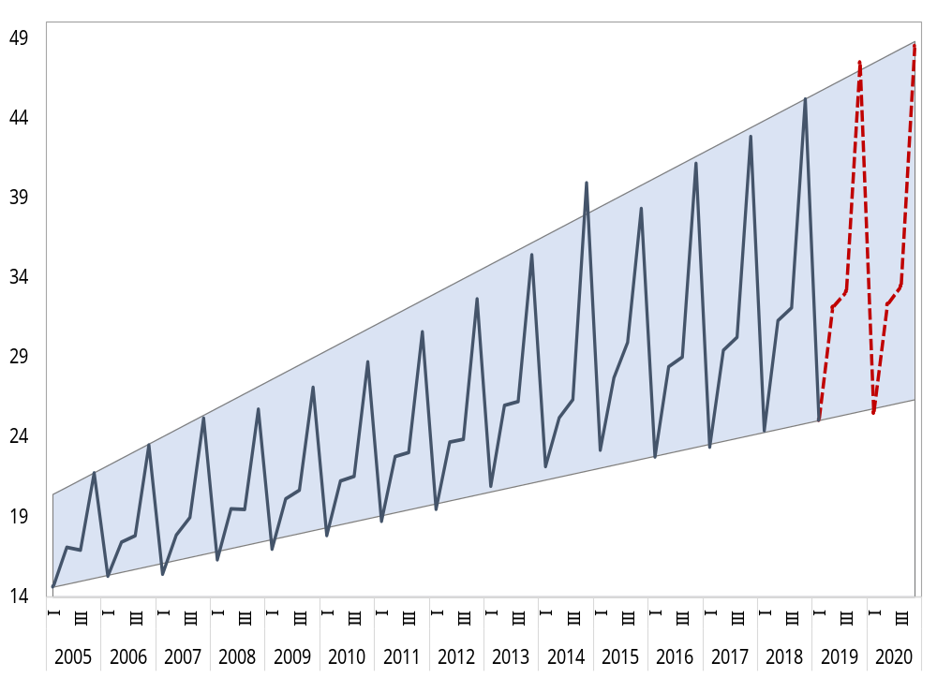
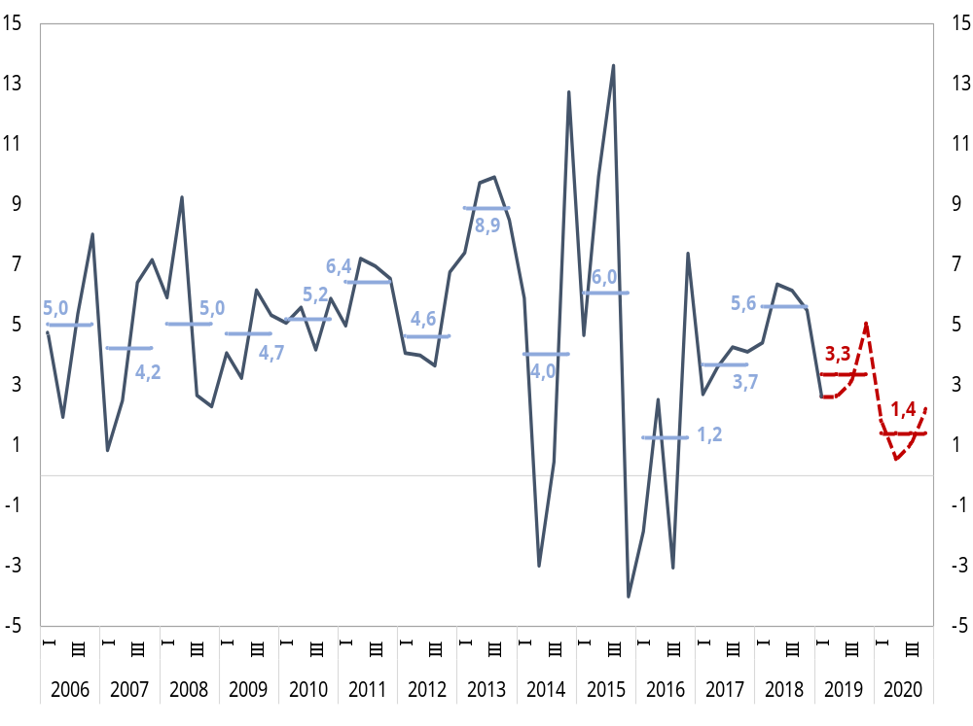
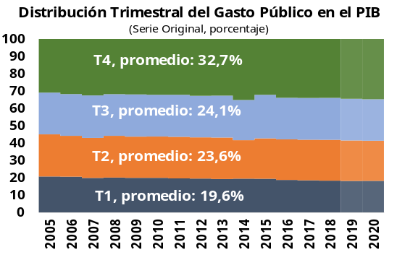
Gasto Público en el PIB
Pronóstico de Gasto Público
Element # 7: Transparent and forward-looking monetary policy strategy - Using budget, cash flow, and “insider” information from meetings with Treasury the CB’s team produces a quarterly forecast for G and T
Public Consumption Level in GDP
(2015 COP, Billions, Original Series)
Annual Growth Forecast for Real Public Consumprion
(Percentahe)
Fuente: DANE, cálculos Banco de la República
Colombia: Coyuntura Económica y Fiscal
27 de Septiembre de 2019

Slide 15
Coordination between Ministry of Finance and Central Bank
Colombia
  Examples of Different Levels of Interaction to Guarantee Effectiveness
Communication – Transparency and Accountability (Element # 8)
  We are launching a new Inflation Report
  Goal: improve communication and transparency
  More forward looking and with more information on how forecasts are made
  More relevant: released in a more timely manner, one day after board meeting
  The board changed their meetings’ agenda, to make sure the Minutes would be released at the same time.
  The need for the change is due to the Ministry sitting at the Board
Interaction between finance ministries and central Banks
September 27, 2019

Slide 16
Coordination between Ministry of Finance and Central Bank
Coordination in practice
  In practice, how does coordination work between the Ministry of Finance and the Central Bank in Colombia?
Macroeconomic policy coordination
Communications
Monetary Policy and
Economic Information
Direction for Macroeconomic Policy
Central Bank
Board of Directors
GDP Nowcast and Forecast process
Fiscal policy analysis
Central Bank
Deputy Technical Governor
Monetary Operations and International Investments
Public Credit and National Treasury
Ministry of Finance
Minister
Treasury deposits – Financial market liquidity needs (daily forecast)
Economic Studies
Direction for National Budget
Interaction between finance ministries and central Banks
September 27, 2019

Slide 17
Coordination between Ministry of Finance and Central Bank
Why?
  Then, how the interaction should be structured?
Two key elements
Regular dialogue | Information sharing
Institutional meetings | Data
Committees | Analysis
Interaction between finance ministries and central Banks
September 27, 2019

Slide 18
How should be the interaction between Ministry of Finance and Central Bank be structured?
7th Annual Conference of the Bilateral Assistance
and Capacity Building for Central Banks (BCC) programme
Interaction of fiscal and monetary policies
September 27, 2019

Slide 19
Coordination between Ministry of Finance and Central Bank
Why?
  References
Blanchard, O. (2004). Fiscal dominance and inflation targeting: lessons from Brazil (No. w10389). National Bureau of Economic Research.
Central Bank of Brazil. Retrieved from: https://www.bcb.gov.br/en
Central Bank of Chile. Retrieved from: https://www.banxico.org.mx/indexEn.html
Central Bank of Colombia. Retrieved from: http://www.banrep.gov.co/
Colombian Constitution of 1991.
Moser-Boehm, P. (2006, March). The relationship between the central bank and the government. In Central banks and the challenge of development, A special meeting of governors held at the BIS, Basel (pp. 14-15).
Interaction between finance ministries and central Banks
September 27, 2019

