Slide 1
Interaction of Fiscal and Monetary Policies
How should the interaction between finance ministries and central banks be structured?
Marouane El ABASSI
Governor of the Central Bank of Tunisia
Geneva, 27th September 2019

Slide 2
Prolonged political transition, the fallout from the crisis in Libya, many exogenous shocks, including terrorist attacks have had strong negative consequences on the national economy.
Political and social instability
Low economic activity
Unemployment rate remains high
Persistent social tensions especially in production sites
Deterioration of the composition of public expenditure
High external imbalances
Increasing debt / GDP ratios
Downgrades by rating Agencies
Price-wage spiral keeping up pressure on inflation
Higher inflation

Slide 3
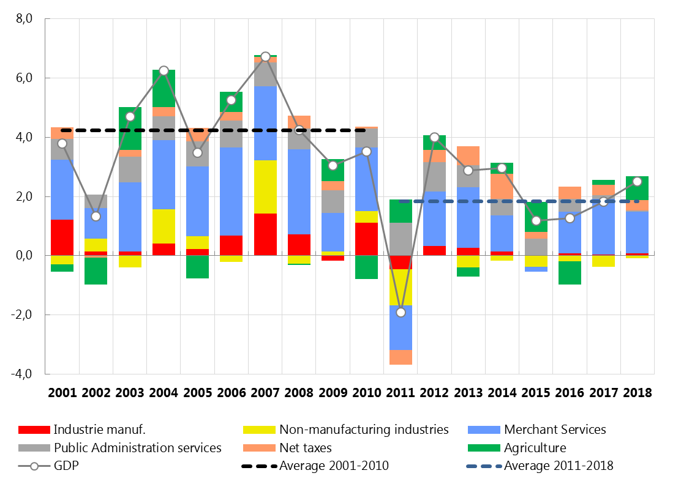
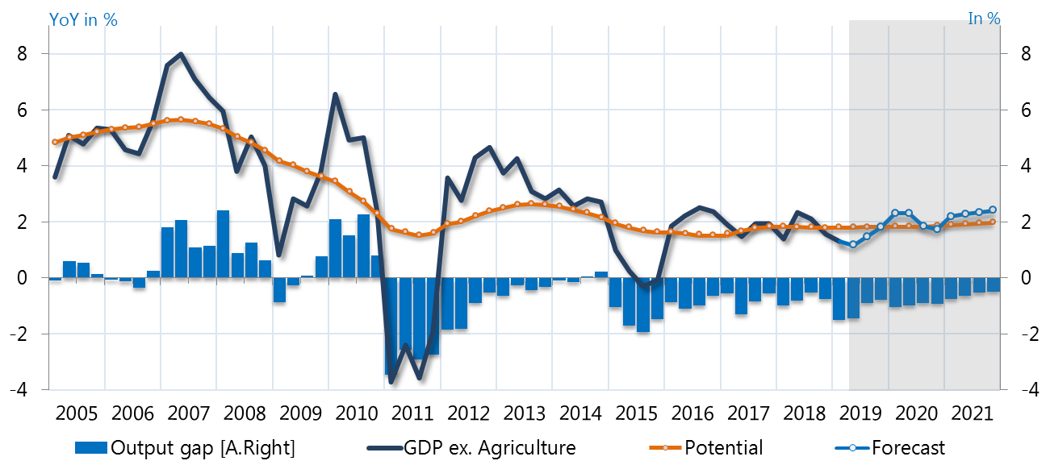
Despite the gradual strengthening of the GDP in recent years, the economic activity seems to be caught in a low growth trap.
Chart: Sectoral contribution to GDP growth (In %)
Chart: Non-agricultural GDP Growth, its potential and the Output gap

Slide 4
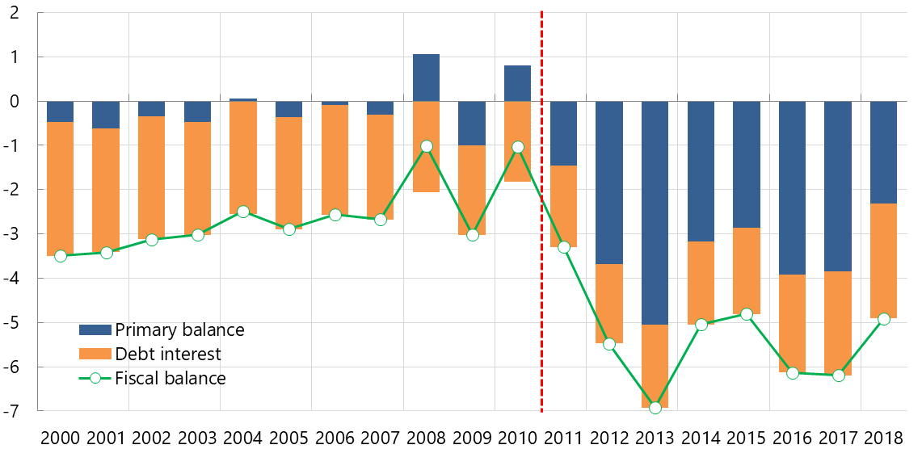
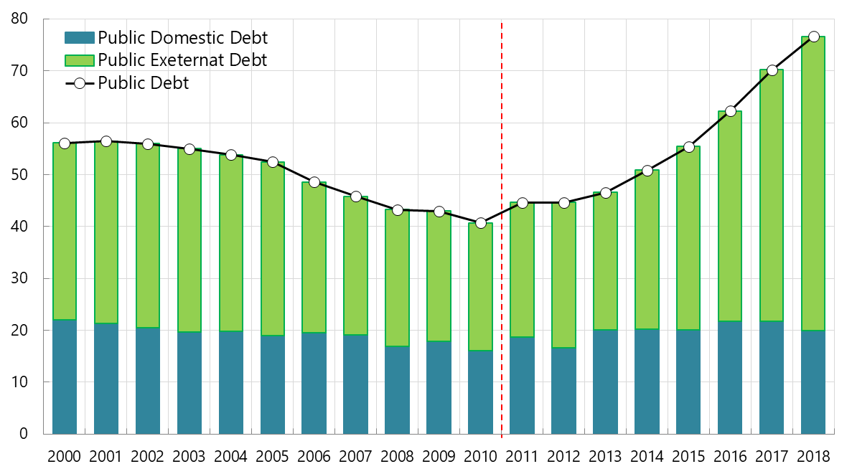
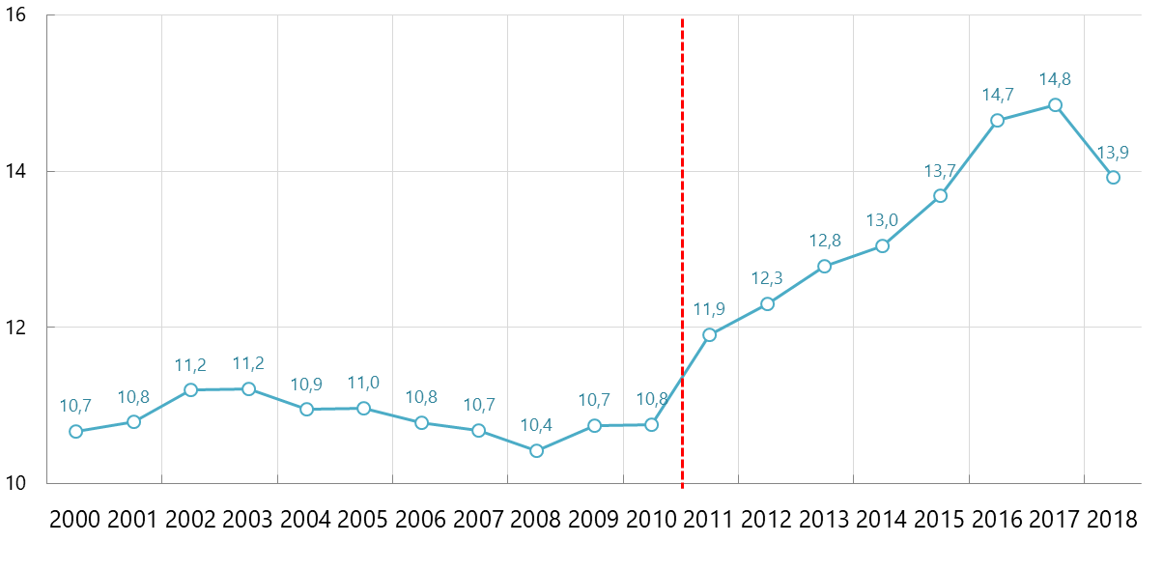
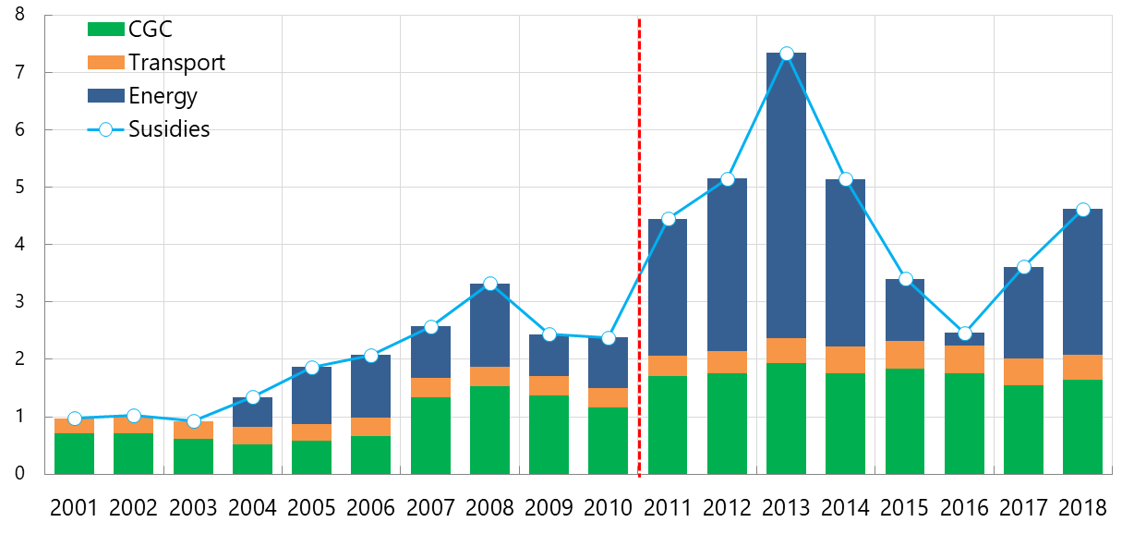
Deep changes in the composition of spending with a significant impact on the budget balance and public debt.
Chart: Public budget balance (In % of GDP)
Chart: Public debt (In % of GDP)
Chart: Wages and salaries for public Administration (In % of GDP)
Chart: Subsidies (In % of GDP)

Slide 5
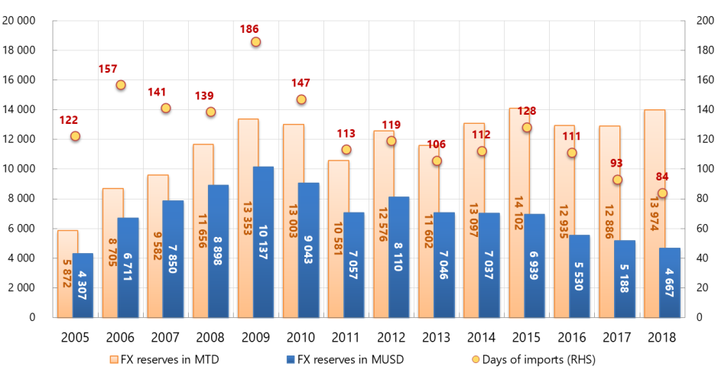
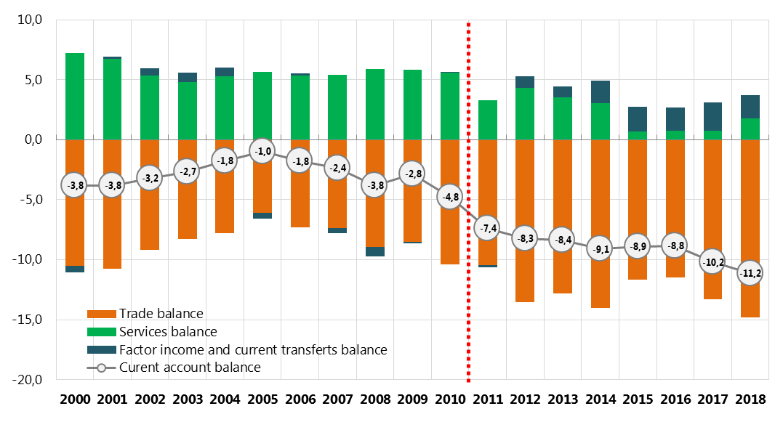
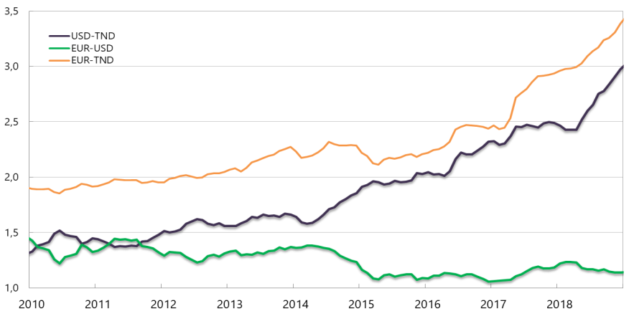
Deteriorating current account deficit resulting from an abyssal trade deficit, leading to erosion of foreign exchange reserves and increased pressure on the dinar exchange rate
Chart: FX reserves
Chart: Current account balance (In % of GDP)
Chart: Exchange rates

Slide 6
Deterioration in sovereign rating due to political, social and security instability and weakening of key macroeconomic indicators ➔ Difficulties to access the international financial markets, rising insurance premium, low ability to attract FDI ...
Chart: Evolution of the sovereign rating of Tunisia between 2010-2018
BBB
Stable outlook
BB-
Stable outlook
B+
Negative outlook
FITCH
2010
2015
2018
Baa2
Stable outlook
Ba3
Stable outlook
B2
Negative outlook
MOODY’S
2010
2015
2018
A-
Stable outlook
BB+
Negative outllok
BB
Negative outllok
R&I
2010
2015
2018
Investment grade
Speculative grade
Source: www.bct.gov.tn

Slide 7
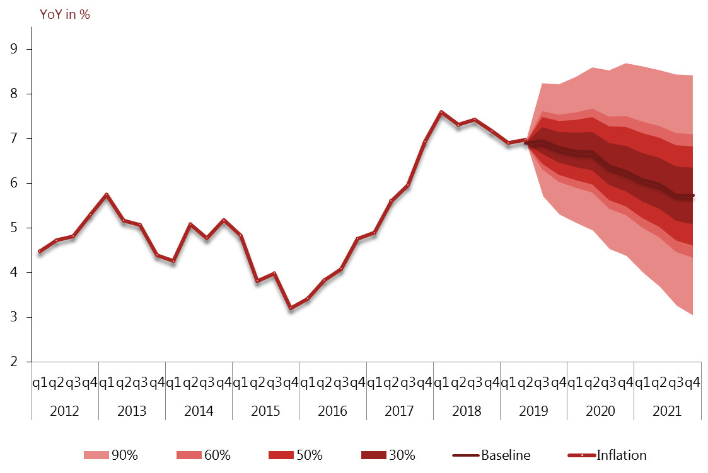
Price pressure continued throughout 2018, while firming up. The inflation rate came to 7.3% yoy, compared to 5.3% the year before.
Chart: Inflation outlook 2019-2021

Slide 8
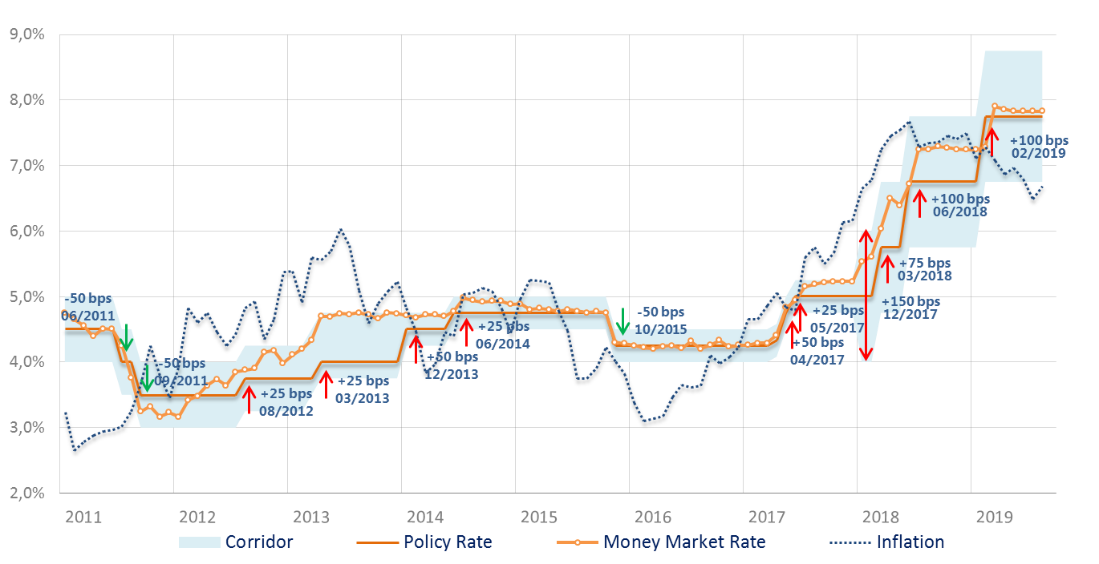
A proactive monetary policy to counter inflationary pressure
Chart: Monetary Policy Stance since 2011
Last observations: August 2019

Slide 9
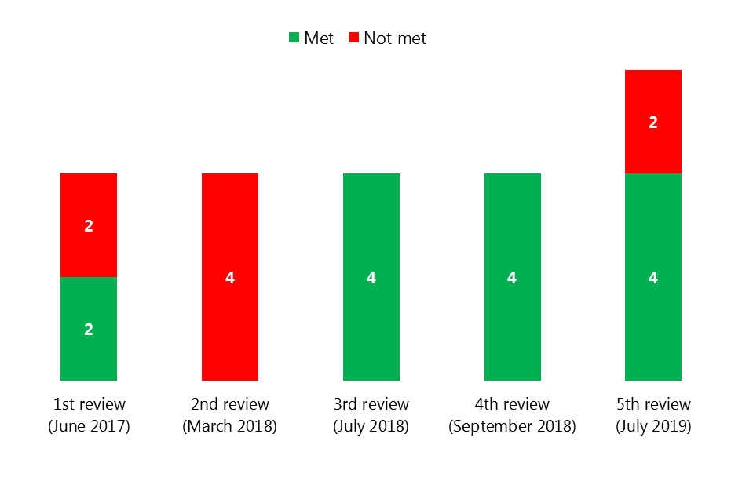
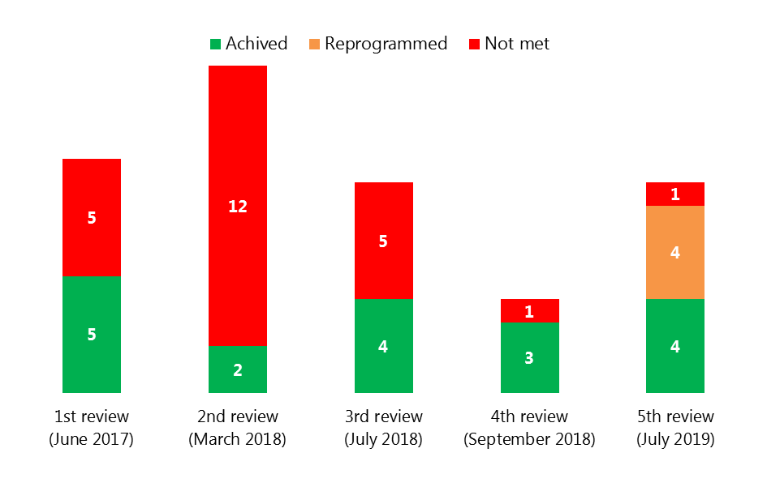
Strong coordination between monetary policy and fiscal policy has helped to redress the imbalances, to carry out the reforms and to keep the IMF Program on-track
Chart: Performance under Extended Facility Fund Program
Quantitative criteria
Chart: Performance under Extended Facility Fund Program
Structural Reforms

Slide 10
Further coordination between the Central Bank and the Ministry of Finance is underway …
Decashing Strategy by promoting electronic payments and reducing the use of cash in the economy.
Establishing a modern banking system, subject to strong supervision and competition.
Strengthening banking sector resilience and promoting financial intermediation.
Restructuring State-owned banks :
  a risk-based supervision system,
  a proper resolution framework,
  and strengthened regulation.
Financial inclusion through the development of microfinance institutions.
Progressing with energy subsidy (automatic adjustment mechanism) and food (targeted subsidies) reforms while strengthening the social safety net,
Fostering the monitoring and performance of the State Owned Enterprises (SOEs).

Slide 11
Thank you for your attention

