Slide 1
Changing cyclicality and predictability of fiscal policies: how do they affect the conduct of monetary policy?
Belma Čolaković
Geneva, September 27th 2019
7th Annual Conference of the Bilateral Assistance and Capacity Building for Central Banks (BCC) Programme
The views and opinions expressed in this presentation are those of the author, and do not necessarily reflect the position of the CBBH.

Slide 2
Various aspects of fiscal policy
Functionally: to allocate, to distribute, to stabilize.
Short vs long term focus
Are there in place, and how strong are the automatic stabilizers
But, in the essence, the ability of fiscal sector to influence economic activity depends on the fiscal space, i.e. on the ability of government to engage additional sources of financing at reasonable cost, or its ability to change the priorities and the levels of current expenditures.

Slide 3
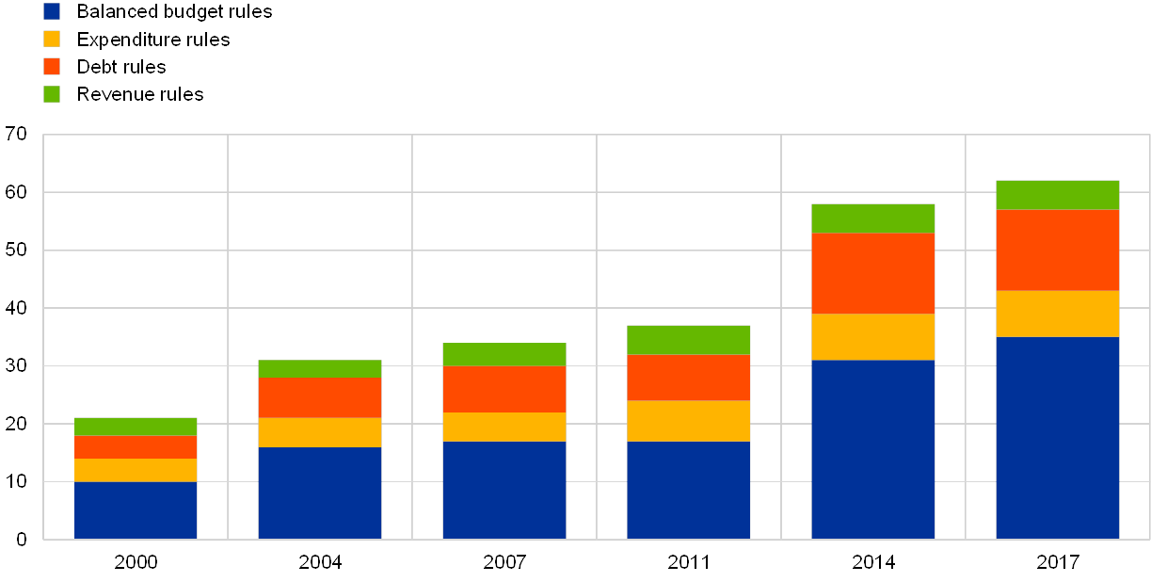
The level of discretion matters when estimating the potential fiscal space
National fiscal rules in the euro area
Taken from ECB Economic Bulletin, Issue 3/2019, the article by Leiner-Killinger and Nerlich.

Slide 4
The effect of fiscal stimulus could be largely unknown ex ante
The intensity of the effect of fiscal policy, the fiscal multiplier, will be conditional on several factors, in addition to the level of stimulus.
  Leakages in the system;
  Monetary conditions;
  Potential concerns regarding budget and debt sustainability;
  Timing of government stimulus;
  Type of government stimulus.

Slide 5
The lags matter, and how much do we really know about the government finance
Statutory framework
  Statistical lag
  Legislative lag
  Implementation or transmission lag
  Time for the effects to show up
How large is the government sector
  Are there arrears?
  Contingent liabilities?
  Are SOEs included?
  The role of the state as the employer.

Slide 6
Fiscal space in BH
Source: CBBH, BHAS.
Six fiscal rules, all prescribed by the law (Law on Borrowing, Debt and Guarantees in BiH; Law on Settlement of Liabilities from Foreign Currency Deposit Savings; Law on Debt, Borrowing and Guarantees in FBiH; Law on Borrowing, Debt and Guarantees in RS; and Law on Internal Debt of DB)

Slide 7
The role of central banks
Should central banks stabilize the economy?
Can monetary policy affect the real aggregate output in a systematic and efficient manner, both in short and long run?
Can central bank stabilize cyclical fluctuations without stepping over its legally prescribed mandate?
Is it better to run the monetary policy with a large discretionary space, or based on clearly defined and transparent set of rules and strategies?

Slide 8
The CBBH required reserves policy in the context of economic activity
Source: CBBH.

Slide 9
Thank you for your attention.

