Slide 1
Costs of Sovereign Default:
Restructuring Strategies, Bank Distress and the Capital Flow-Credit Channel
Tamon Asonumaª Marcos Chamon^{b} Aitor Erce^{c} Akira Sasahara^{d}
IMF IMF ESM University of Idaho
September 26, 2019
7th Annual Conference of the Bilateral Assistance and
Capacity Building for Central Banks (BCC) programme
The views expressed herein are those of the authors and should not be attributed to the European Stability Mechanism or the International Monetary Fund, their Executive Boards, or their Management. ª IMF, TAsonuma@imf.org ^{b} IMF, MChamon@imf.org
^{c} ESM, a.erce@esm.europa.eu ^{d} UC Davis, sasahara@uidaho.edu

Slide 2
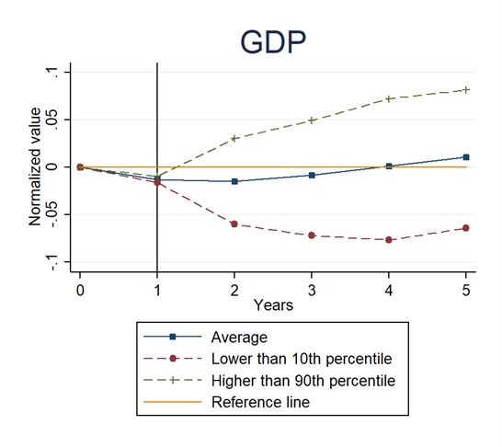
Motivation
Restructurings on privately-held external debt issued by sovereign debtors
Why costs of defaults vary substantially across episodes?
Sources: Asonuma and Trebesch (2016) and Penn World Table 8.0. GDP (real) is measured as a deviation from the H-P filtered trend.

Slide 3
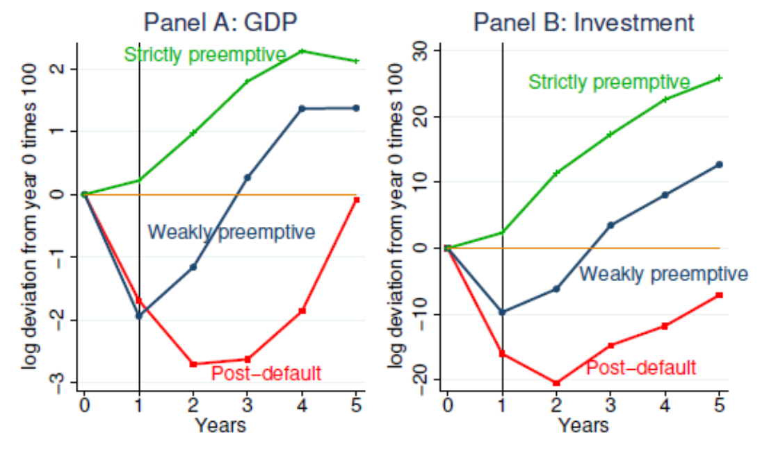
Restructuring Strategy: Growth and Investment
Restructuring Strategies (Asonuma and Trebesch 2016)
  Strictly preemptive : No missed payments at all (no legal default)
  Weakly preemptive : Some missed payments, but only temporarily and after the start of negotiations
  Post-default : Unilaterally missed payments (unilateral default prior to negotiations)
Sources: Asonuma and Trebesch (2016) for restructurings, Penn World Table 8.0 (Feenstra et al. 2015) for GDP and investment. GDP (real) is measured as a deviation from a Hodrick-Prescott filtered trend and investment (real, flow) is normalized at the pre-crisis (t = 0) level. Black vertical lines correspond to the start of restructurings (at t =1).

Slide 4
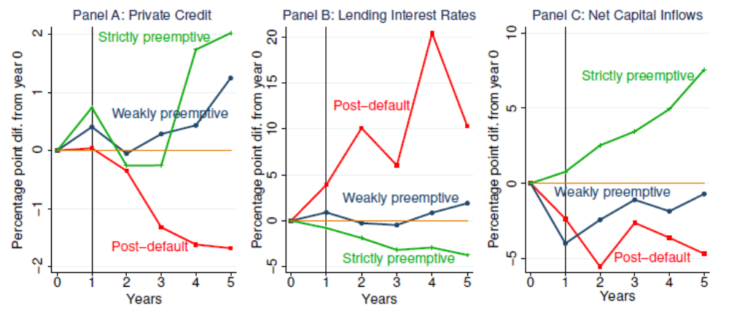
Restructuring Strategy:
Credit and Capital Flows
Sources: Asonuma and Trebesch (2016, restructurings), WB WDI (private credit), IMF IFS (lending interest rates) and IMF WEO (net capital inflows). Private credits (real), lending interest rates (nominal), and net capital inflows (real) are normalized at the pre-crisis level (t = 0) respectively.

Slide 5
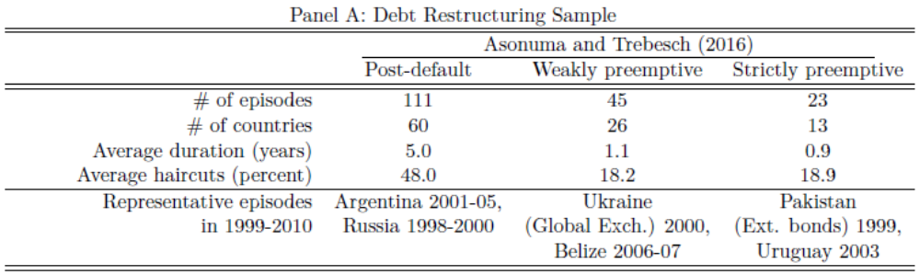
Restructuring Sample
Sample of external debt restructurings in 1978-2010
Preemptive restructurings have on average (Asonuma and Trebesch 2016):
  Shorter duration
  Smaller haircuts
  Shorter period of market exclusion

Slide 6
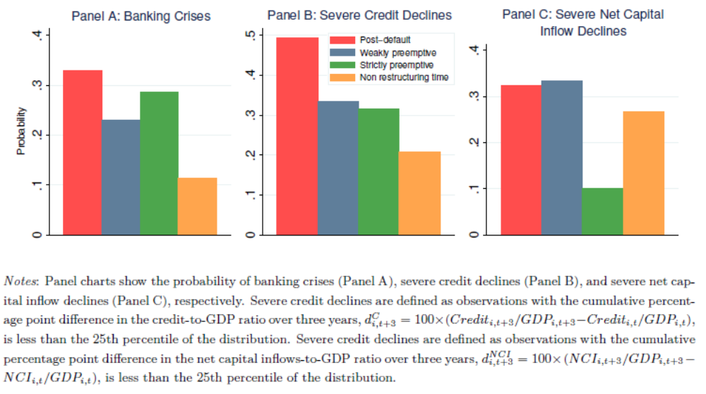
Banking Crises, Credit Crunches and Capital Flow Reversals

Slide 7
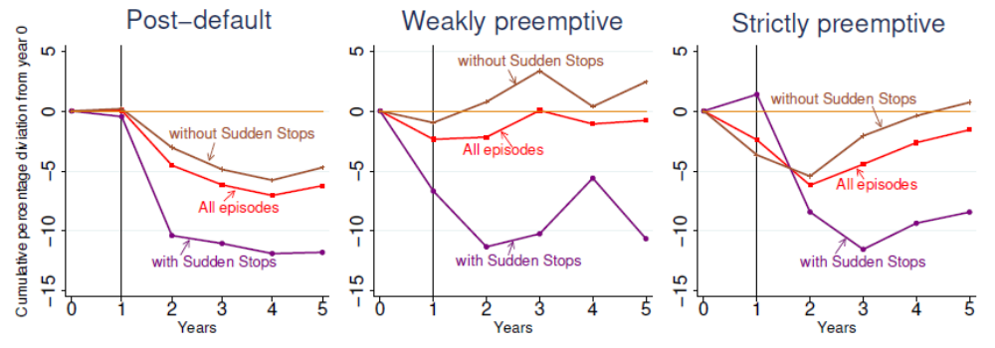
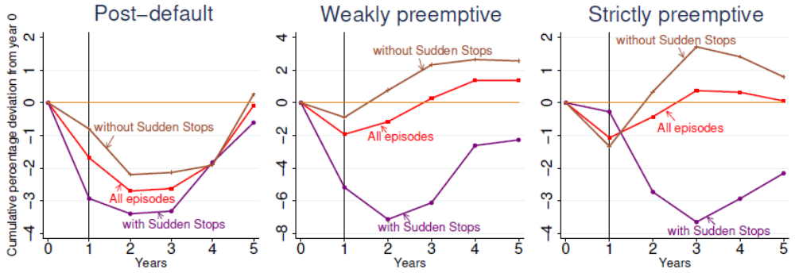
Transmission Channels across Strategies
Panel A: Private Credit
Panel B: GDP
Sources: Sudden stops are defined as observations with the percentage point difference in the net capital inflows-to-GDP ratio from year 0 to year 1, dNCI_i,t+1 = 100×(NCI_i,t+1/GDP_i,t+1 −NCI_i,t/GDP_i,t), is less than the 25th percentile of the distribution. The 50th percentile cutoff is employed for the post-default cases in Panel B. Black vertical lines correspond to the start of restructurings (at t =1). GDP (real) and private credit (real) are detrended using the Hodrick-Prescott filter.

Slide 8
Related Literature
I. Output costs of defaults
  Sturzenegger (2004), Tomz and Wright (2007), Borensztein and Panizza (2009), Levy-Yeyati and Panizza (2011), Asonuma and Trebesch (2016), Trebesch and Zabel (2017), Kuvshinov and Zimmermann (2016)
  Our paper identifies transmission channels of output costs
  II. Sovereign and banking crises
    Reinhart and Rogoff (2009, 2011), Borensztein and Panizza (2009), Balteanu and Erce (2014), Sandleris (2015), Gennaioli et al. (2014), Sosa-Padilla (2018)
    Our paper provides new evidence on these linkages
  III. Designing a new debt restructuring scheme
    IMF (2014), Brookings-CIEPR (2013), Fernandez and Martin (2014) and Mariscal et al. (2015)
    Our paper shows that adverse costs are associated with financial sector linkages and those could be avoided by restructuring debt preemptively

Slide 9
Local Projection
Local projection (Jordà 2005): The overall cumulative effect of the restructuring strategy over a long horizon
  Estimates the effect at t+h of a restructuring at t+1 even if there were additional restructurings during that time.
  These estimates will capture further losses if there is a second restructuring
Endogeneity of restructurings: Countries’ restructuring choice and strategies depend on macroeconomic conditions
Propensity score matching: To reduce selection bias between restructurings and counter-factual (non-restructuring) observations
Overlapping restructurings:
  Our baseline results treat each restructuring independently
  Robustness check applies different approach of dealing overlaps

Slide 10






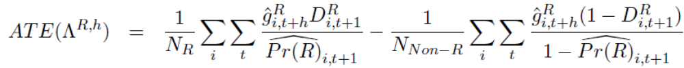

Local Projection
1st stage: Propensity score estimation:
  Instruments : i) ext. debt/GDP, ii) interest payments/GDP, iii) change in credit ratings, iv) political stability index, v) past restructuring history,
  vi) recent banking crises
Local projection equation:
  Cum. GDP growth from t to t+h in country i :
  Dummy variable for a post-default restructuring:
  Additional controls : a) the lagged dependent variable, b) cyclical component of log of GDP obtained from the HP filer
  Coefficients to be estimated:
  Error terms from each regression:
Predicted dependent variable:
2nd stage: Average treatment effect of debt restructurings
  Estimated probability of restructuring:

Slide 11
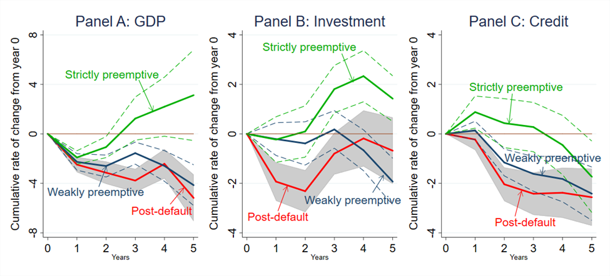
Output Costs across Restructurings
2nd-stage average treatment effect estimation
Notes: The figures show local projections (AIPW) of the variables shown in each panel for h = 1, 2,.., 5, where h indicates horizon. Solid lines in red, blue and green are point estimates. Gray bands and dotted lines in blue, and green are 95% confidence intervals. The sample period is 1970–2013.

Slide 12
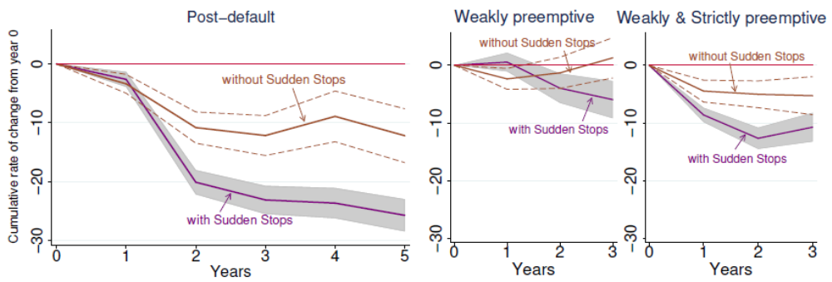
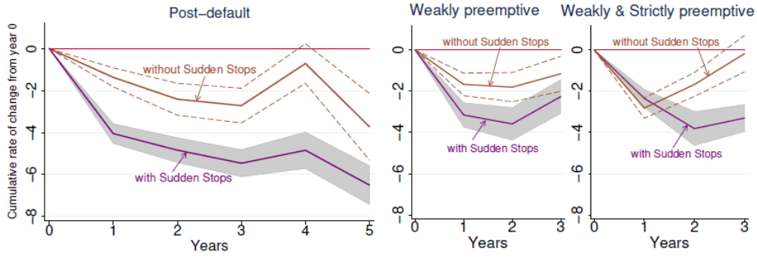
Transmission Channels across Strategies
Panel A: Private Credit
Panel B: GDP
Notes: Sudden stops are defined as observations with the percentage point difference in the net capital inflows-to-GDP ratio from year 0 to year 1, dNCI_i,t+1 = 100×(NCI_i,t+1/GDP_i,t+1−NCI_i,t/GDP_i,t), is less than the 25th percentile among the observations experiencing that type of restructurings for Panel A. The 50th percentile cutoff for Panels B in order to have enough number of observations for both groups. The figures show AIPW estimates of the variable shown in each panel for h = 1, 2, .., 5, where h indicates horizon. Solid lines in brown and purple are point estimates. Gray bands and dotted lines in brown are 95% confidence intervals. The sample period is 1970–2013.

Slide 13
Robustness Check
OLS Results
Expanded Sample (including countries without restructuring experience) – OLS
Restructurings with Paris Club Restructurings or IMF-supported Programs – Panel OLS
“Single” External Debt Restructurings - AIPW
Sequential Restructurings with no Overlapping Years
Sequential Restructurings with the “Initial” Strategy
Sequential Restructurings with the “Worst” Strategy
Enlarged Set of Instruments – AIPW

Slide 14
Policy Implications
Adverse costs may be substantially mitigated if debt can be restructured without payments being missed.
  Under preemptive restructurings, credit crunches/capital flow reversals are less likely to occur, softening the impact on investment and GDP
Results support reprofiling countries in the “gray zone” of debt sustainability.
  Even though some preemptive restructurings were followed by a second restructuring, on average they yielded lower expected output costs
Health of banking system affects choice of strategy
  Banking crises more likely prior to a preemptive than a post-default restructuring. Suggests financial stability concerns already a significant factor in choice of how to restructure.

Slide 15
Backup Slides

Slide 16
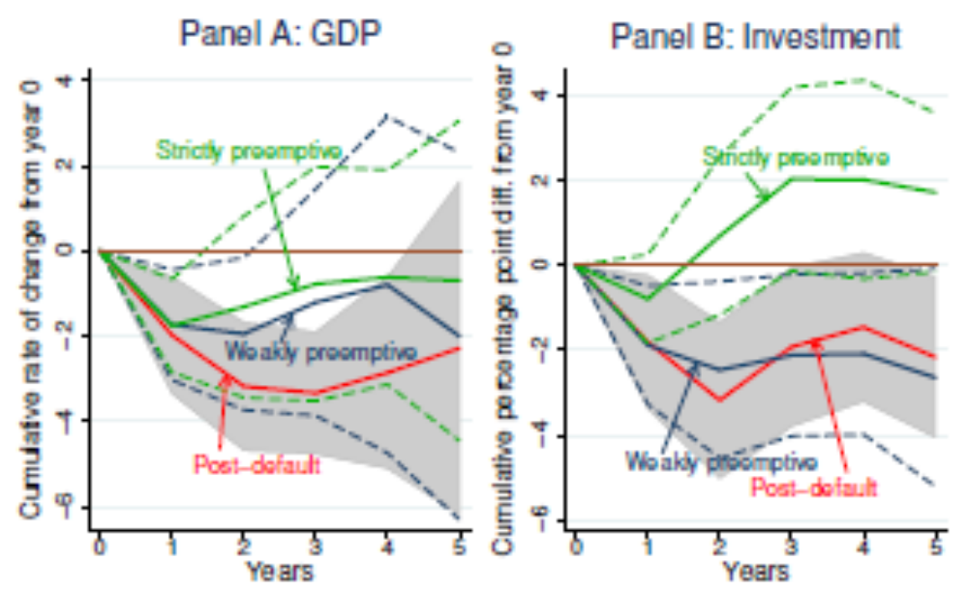
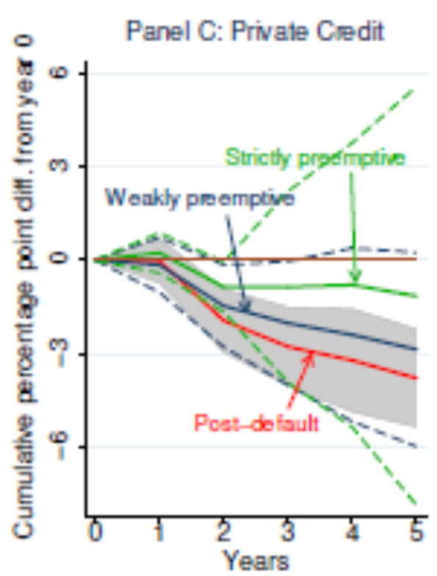
Robustness Check – Expanded Sample (OLS)
Notes: The figures show local projections (OLS) of the variables shown in each panel for h = 1, 2,.., 5, where h indicates horizon. Solid lines in red, blue and green are point estimates. Gray bands and dotted lines in blue, and green are 95% confidence intervals. The sample period is 1970–2013.

Slide 17
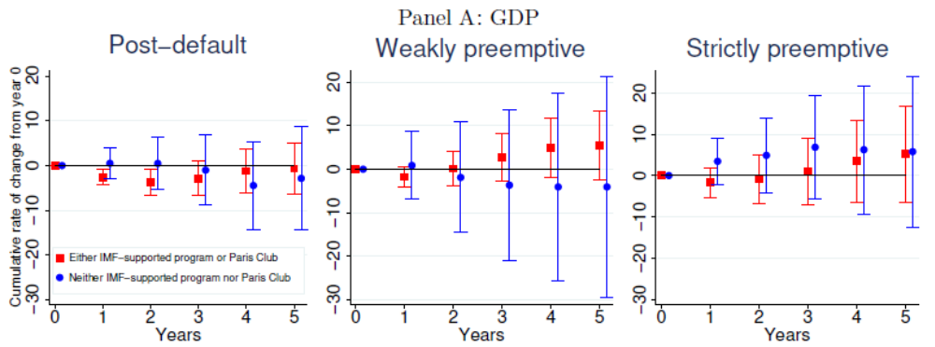
Robustness Check – Paris Club Restructurings or IMF-Supported Programs (Panel OLS)
–
Notes: The figures show panel OLS regressions of the variables shown in each panel for h = 1, 2, .., 5, where h indicates
horizon. Square dots in red and circle dots in blue are point estimates for private debt restructurings with and without
IMF-supported programs or official (Paris Club) debt restructurings. Upper and lower limits of lines in red and blue
indicate 95% confidence intervals. The sample period is 1970–2013.

Slide 18
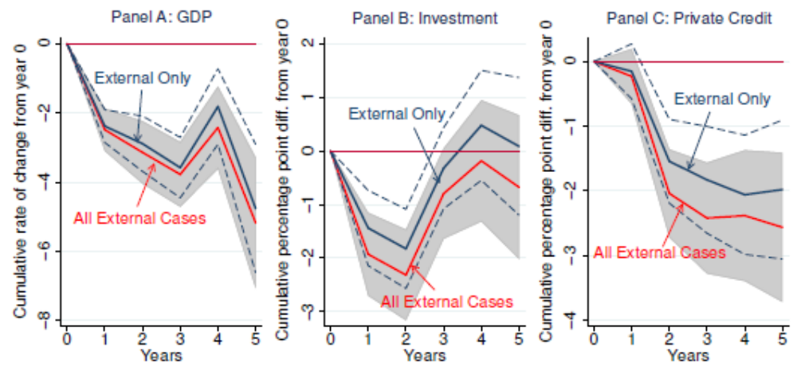
Robustness Check – “Single” External Debt Restructurings (AIPW)
Panel A: Post-default Restructurings
Note: The figure shows local projections of GDP for h = 1, 2, …, 5, where h indicates horizon. Red and blue solid lines are point estimates for all external debt restructurings and “single” debt restructurings. Gray band and dotted lines in blue indicate 95 percent confidence intervals. The sample period is 1970–2013.

Slide 19
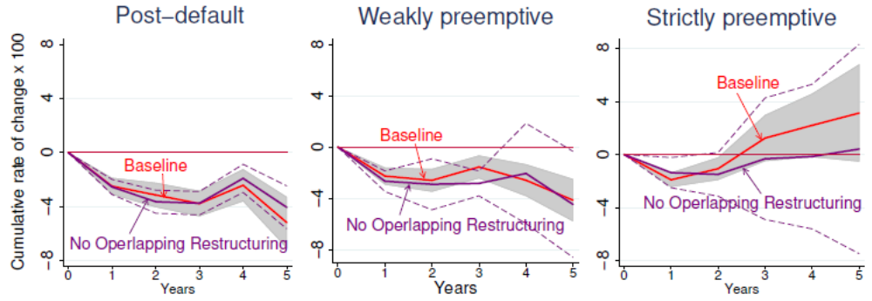
Robustness Check –Sequential Restructurings without Overlapping Years (AIPW)
Panel A: GDP under Individual Restructurings without Overlapping Years
Note: A credit crunch is defined as observations with the cumulative growth rate of private credit from year 0 to year h is negative where h is set to 5, 3, and 2 for post-default, weakly preemptive, and strictly preemptive cases, respectively, where these thresholds are chosen based on the average duration of debt restructuring episodes. Figures show local projections of the variable shown in each panel for h = 1, 2, …, 5, where h indicates horizon. Red solid and blue dash lines are point estimates. Dotted lines in red and blue indicate 95 percent confidence intervals.

Slide 20
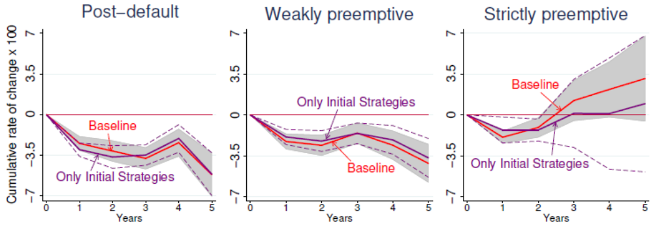
Robustness Check – Sequential Restructurings with the “Initial” Strategy (AIPW)
Panel B: GDP under Sequential Restructurings with the “Initial” Strategy
Note: A credit crunch is defined as observations with the cumulative growth rate of private credit from year 0 to year h is negative where h is set to 5, 3, and 2 for post-default, weakly preemptive, and strictly preemptive cases, respectively, where these thresholds are chosen based on the average duration of debt restructuring episodes. Figures show local projections of the variable shown in each panel for h = 1, 2, …, 5, where h indicates horizon. Red solid and blue dash lines are point estimates. Dotted lines in red and blue indicate 95 percent confidence intervals.

Slide 21
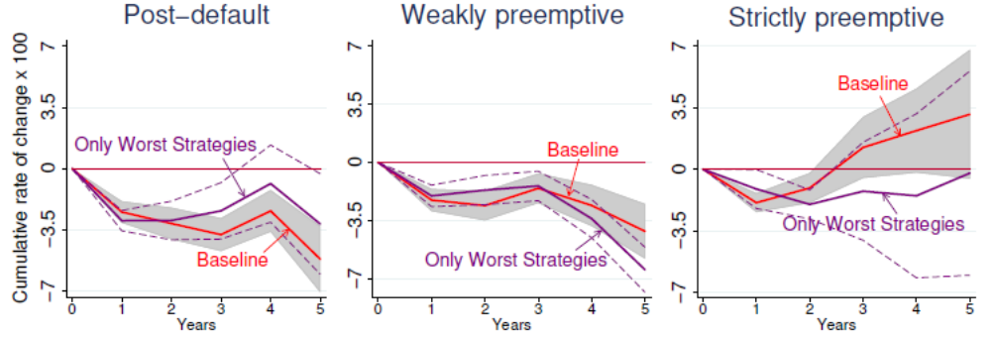
Robustness Check –Sequential Restructurings with the “Worst” Strategy (AIPW)
Panel C: GDP under Sequential Restructurings with the “Worst” Strategy
Note: A credit crunch is defined as observations with the cumulative growth rate of private credit from year 0 to year h is negative where h is set to 5, 3, and 2 for post-default, weakly preemptive, and strictly preemptive cases, respectively, where these thresholds are chosen based on the average duration of debt restructuring episodes. Figures show local projections of the variable shown in each panel for h = 1, 2, …, 5, where h indicates horizon. Red solid and blue dash lines are point estimates. Dotted lines in red and blue indicate 95 percent confidence intervals.

